Slide 1
Ecology
Population Dynamics- Global Carrying Capacity

Slide 2
Population Dynamics
Ecologists can determine an average population size, though not as important as the variation in numbers from year to year
Population Dynamics-focuses on complex interactions between biotic and abiotic factors that cause variation in population size

Slide 3
Stability and Fluctuation
Long-term studies challenge early hypothesis that large mammals have stable populations
However large animals are more stable than smaller ones (moose vs. Dungeness crab)
Dynamics of populations result from a complex interaction of biotic and abiotic factors

Slide 4
Metapopulations and Immigration
Metapopulation-a group of populations
Immigration and emigration can influence populations

Slide 5
Population Cycles
Some populations fluctuate at unpredictable intervals while others undergo regular boom-and-bust cycles
Some mammals like voles fluctuate in 3-4 year cycles
Snowshow hares and lynx- 10 year cycles

Slide 6
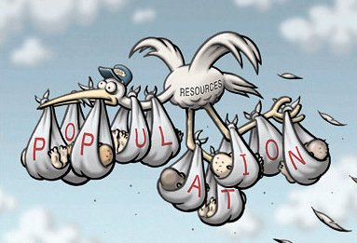
The Global Human Population
Population explosion of humans since 1650
Unlikely any other animal experienced this kind of growth
Grows by 201,000 people each day
Rate of growth began to slow during the 1960’s
Declines are result of fundamental changes in population dynamics due to diseases and voluntary control

Slide 7
Regional Patterns
Population dynamics vary widely from region to region
In stable regions: birth rate equals death rate
Demographic Transition- movement from High birth rate – high death rate to low birth rate – low death rate
Associated with an increase in quality of health care and sanitation as well as improved education

Slide 8
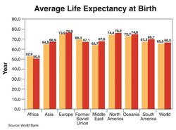
Regional Patterns
In developed nations populations are near equilibrium (growth rate about .1% per year)
Unique feature of humans is ability to plan and use contraception

Slide 9
Age Structure
Important variable is age structure, the relative number of individuals of each age
Can predict population growth trends and illuminate social conditions

Slide 10
Infant Mortality and Life Expectancy
Infant mortality- the number of infant deaths per 1000 births
Life expectancy at birth- the predicted average length of life at birth
Reflect quality of life

Slide 11
Global Carrying Capacity
For 2050 the UN projects a population of 7.5-10.3 billion people
Can biosphere support these people? Will there be overpopulation? Is it already overpopulated?

Slide 12
Estimates of Carrying Capacity
First estimate was 13.4 made by Anton Leeuwenhoek in 1679
Now average of 10- 15 billion capacity
Based off of logistics equation, habitable land, and available food

Slide 13
Ecological Footprint
Humans need food, water, fuel, buidling materials, and other requisites
Ecological footprint- summarizes the aggregate land and water area appropriated by each nation to produce all resources it consumes and to absorb its waste

Slide 14
Ecological Footpring
6 ecologically productive areas: arable land, pasture, forest, ocean, built up land, and fossil energy land

Slide 15
Ecological Footprint
Countries Vary greatly in their individual footprint size and their available ecological capacity
The world was already in ecological deficit when studies were conducted to understand carrying capacity

Slide 16
Ecological Footprint
Beliefs:
We will run out of food
Limited by suitable space
Run out of nonrenewable resources
Human population growth has no practical limits due to technology

