Slide 1
Ecology Project
Adrien Sandercock
2nd Period Granville

Slide 2
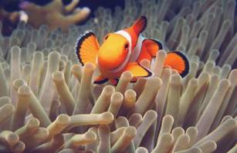
Mutualism
Interspecific relationship that benefits both species
Examples: ants and the acacia, clown fish and sea anemone
Can involve evolution of related adaptations
For example, flowering plants attract their pollinators

Slide 3
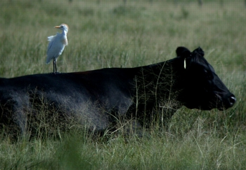
Commensalism
Interspecific relationship where one species benefits, and the other is neither helped nor harmed
Difficult to document due to the fact that close contact nearly always affects both species
Examples: “hitchhiking” algae that grow on turtle shells, birds that feed on insects flushed from the plants by cattle

Slide 4
Adaptation
Interspecific relations can often drive evolution
Predation
Competition
Coevolution
Coevolution-reciprocal evolutionary adaptations of two interacting species
Genetic change in one organism is tied to that in the other
True coevolution is rare; most organisms are guided by predation and competition

Slide 5
Species Diversity
Species Diversity- the variety of kinds of organisms that make up a community
2 Components: species richness and relative abundance
Species Richness- total number of different species in the community
Relative Abundance- proportion each species represent of the total individuals in the community
Diversity is vital to maintaining ecological balance

Slide 6
Trophic Structure
Feeding relationships between organisms in a community
Transfer of food energy up the trophic levels
Sun > Producer (Plant) > Primary Consumer (Herbivore) > Secondary Consumer (Carnivore) > Tertiary Consumers > Quaternary Consumers

Slide 7
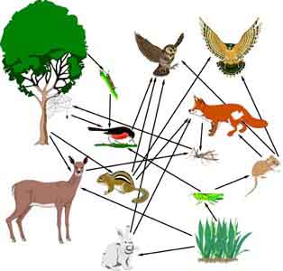
Food Webs
Food chains link together to form food webs
Links species based on who eats whom
Similar species within a trophic level are often grouped together to simplify huge webs

Slide 8
Limits on Food Chain Length
Each food chain generally has only a few links, rarely surpassing seven, and staying mostly at a max length of five (first pointed out by Charles Elton, 1920s)
There are two main hypotheses regarding this:
Energetic Hypothesis
Dynamic Stability Hypothesis
*Energetic Hypothesis-
length of food chain limits efficiency of the transfer of energy
more energy in photosynthetic communities means a longer possible length
10% of energy in each trophic level is passed on to the consumer
Dynamic Stability hypothesis- long food chains are less stable and vulnerable to population fluctuation; changes in lower trophic levels are magnified in the upper levels

Slide 9
Dominant Species
Dominant species- those in a community that are the most abundant or have the largest collective biomass
Have a powerful control over the occurrence and distribution of other species
Example: sugar maples, dominant in many eastern North American forests- impacts abiotic factors like shading and soil nutrients
Example: American chestnut, formerly dominant in eastern North American deciduous forests; wiped out by fungal blight
Elimination of the dominant species can kill species that depend on it, but also allows other species to compete better

Slide 10
Keystone Species
Aren’t necessarily numerous like dominant species, but they too exert strong control due to their critical niche
Maintain the balance of the community
Example: sea otters eat urchins, which eat kelp; in areas with abundant sea otters, there are few urchins and large kelp forests, but in areas with fewer of the otters, there are lots of urchins and no kelp

