Slide 1
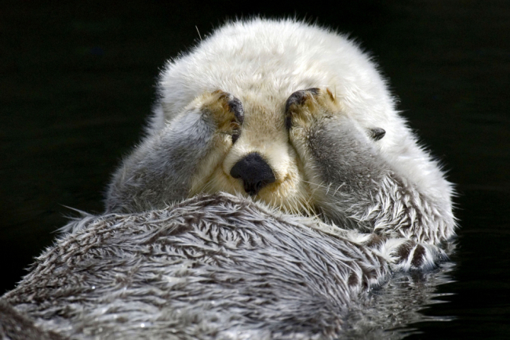
Ecology Review pg. 1080-1084
By: Lindsey Powell

Slide 2
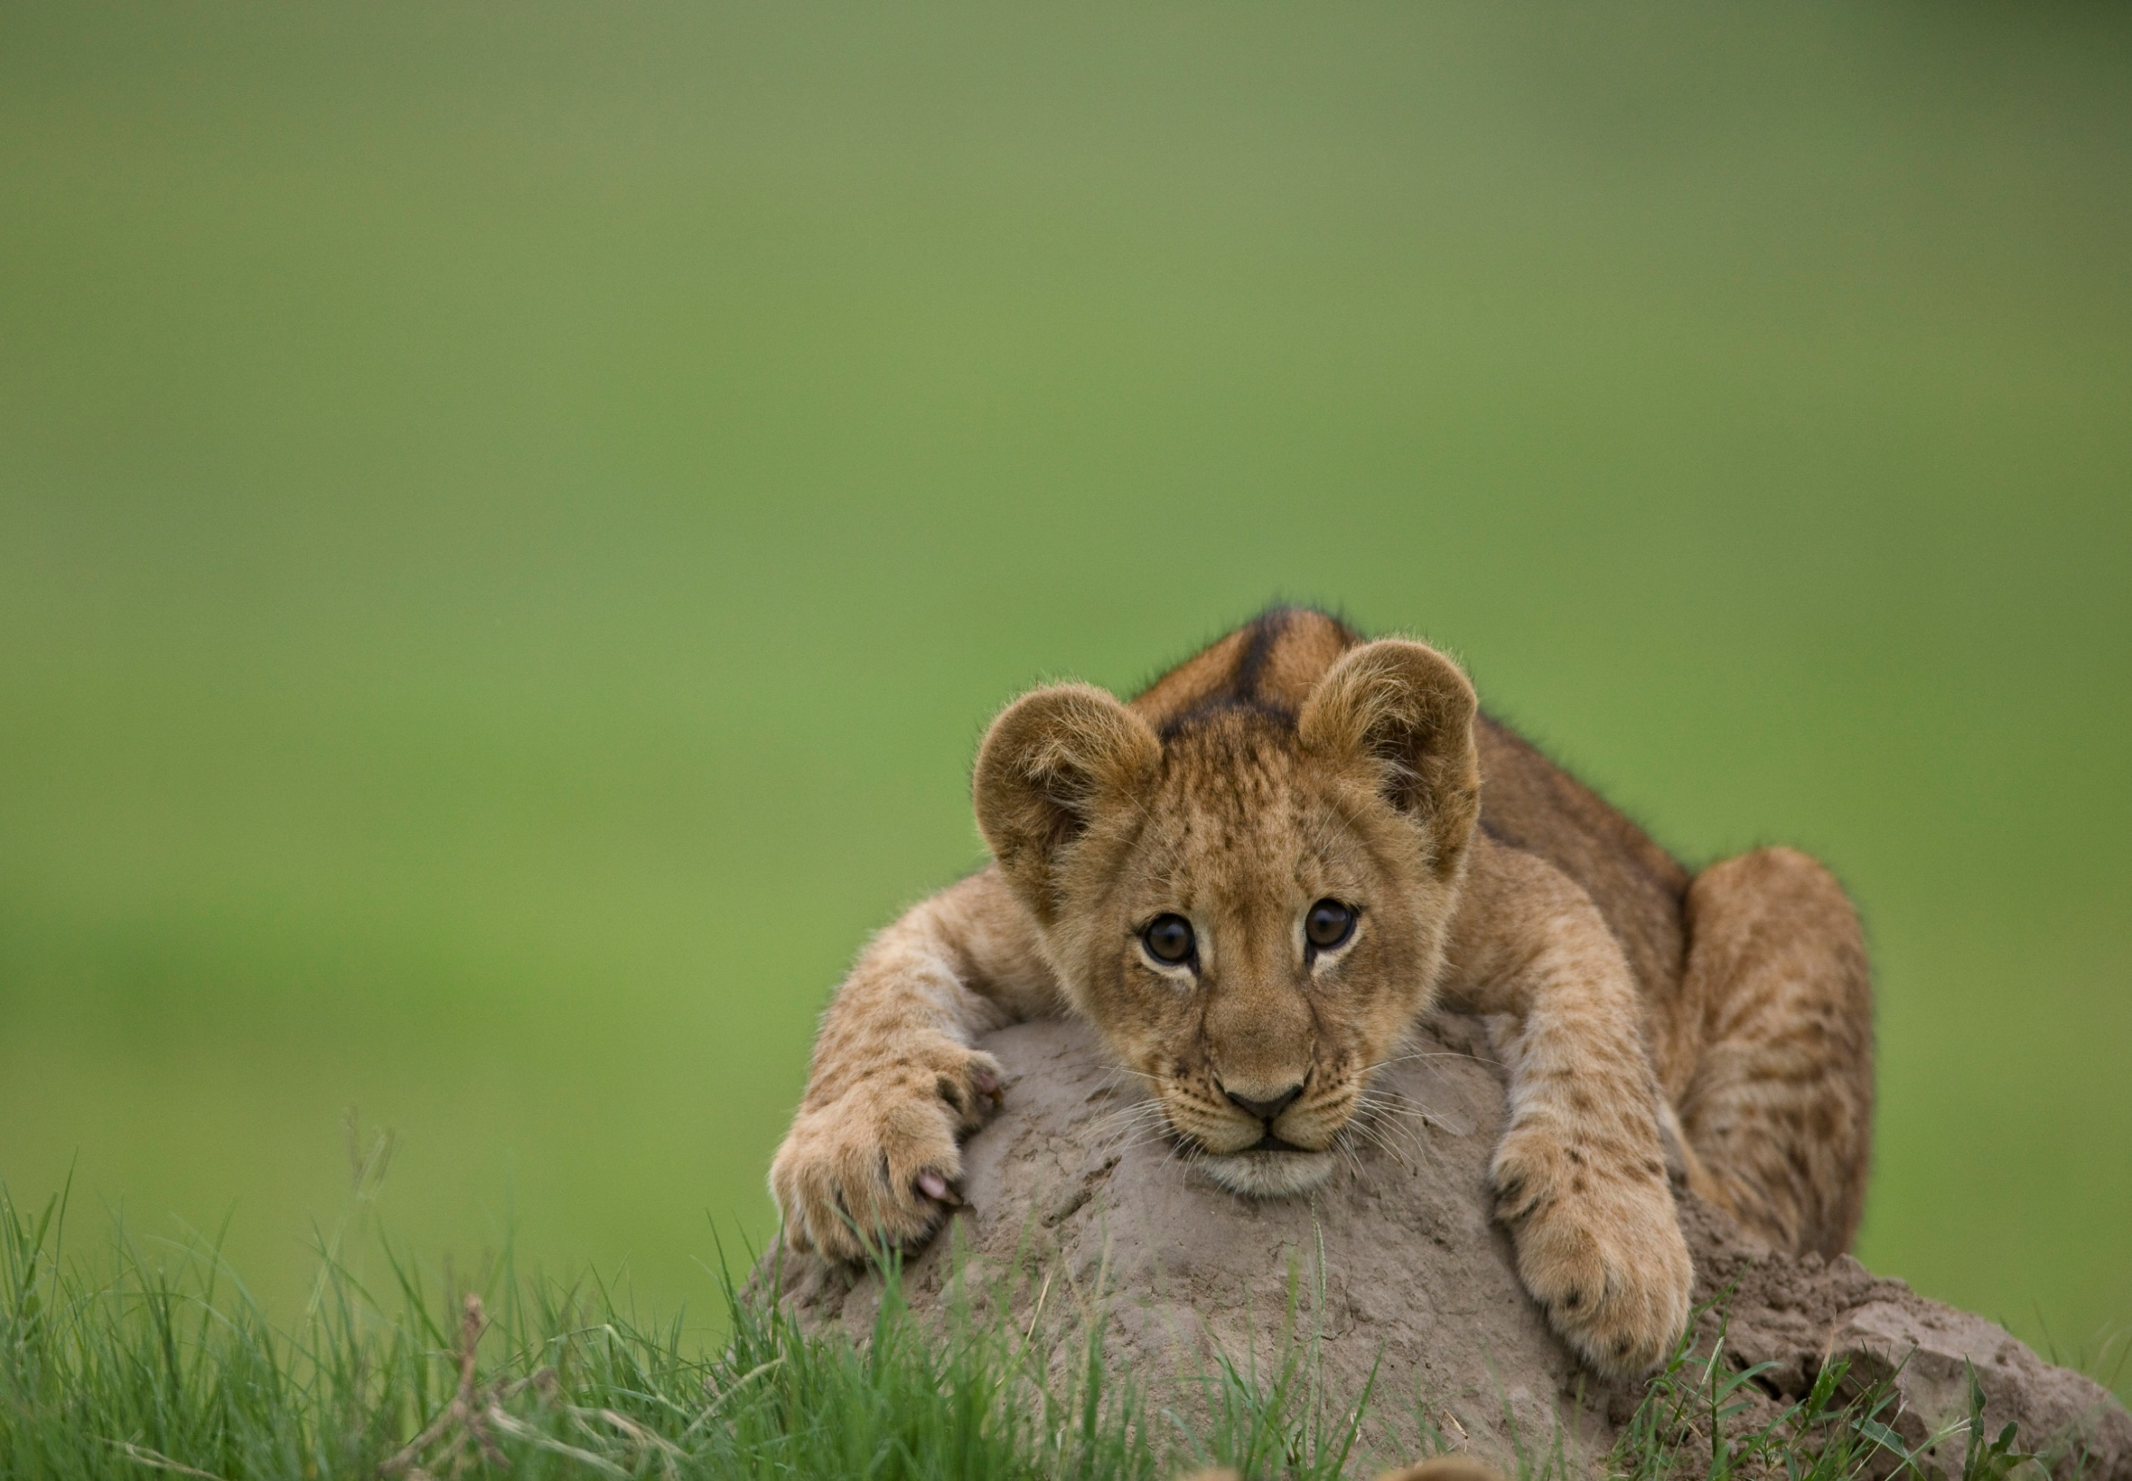
Ecology
Define: the study of the interactions between organisms and the environment
3 Questions:
Where do they live?
Why do they live where they do?
How many are there?
- Interactions are essential
Complex and vast
area of biology,
and very important
- Richness of biosphere

Slide 3
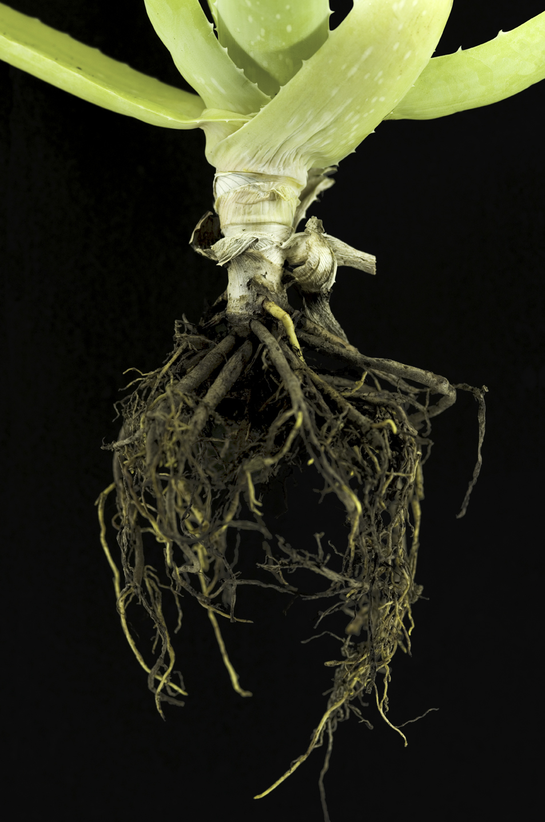
Ecology’s Roots
Large interest in the distribution and abundance of other organisms
Natural history (descriptive science)
Experimental science
Field experiments
Pressure to produce consistent outcomes has resulted in innovative ideas

Slide 4
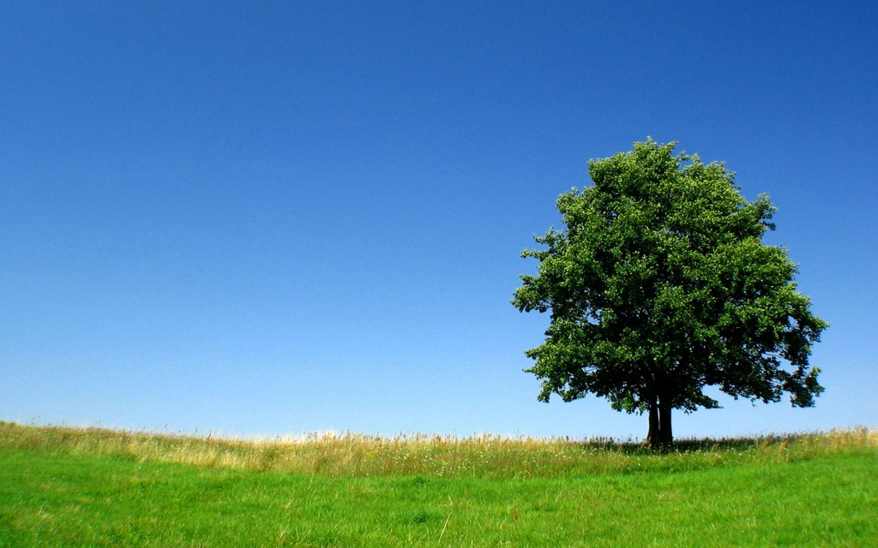
Ecology and Evolutionary Biology
Closely related
Darwin
Ecological Time: minutes,
months, years
Translate into longer scale
of Evolutionary Biology:
decades, centuries,
millennia, and longer

Slide 5
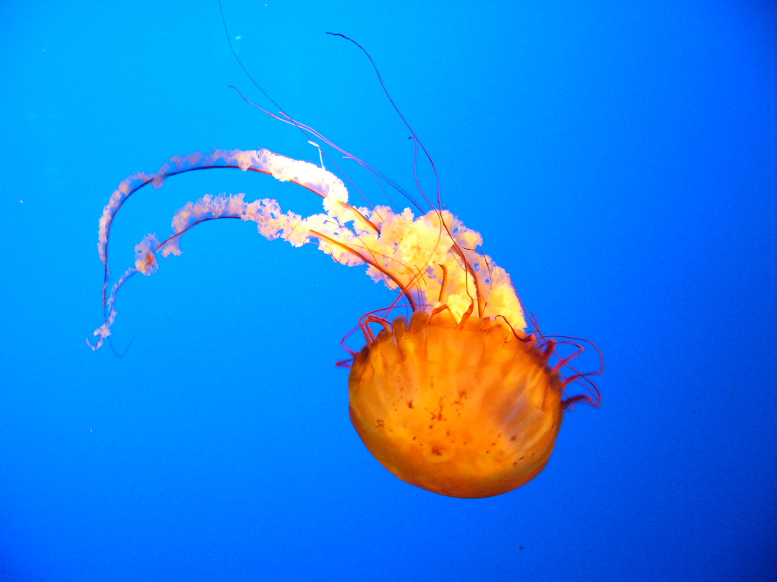
Environmental Factors
Environment consists of:
1. Abiotic Factors – Non-living
Chemical and
physical factors
Ex. Temperature, light, water, nutrients
2. Biotic Factors – Living
- All the organisms in one’s environment
- May compete, prey, parasitize, provide, or change the things around it
- Must consider all factors when analyzing an organism or its environment

Slide 6
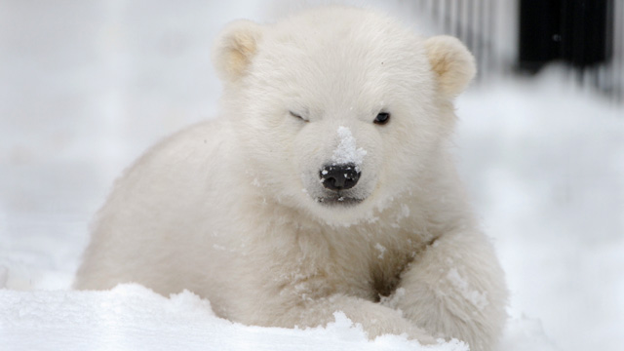
Subfields of Ecology
Organismal Ecology
Population Ecology
- Focuses on how an organisms structure, physiology, and behavior meet the environment’s challenges
- Divided further into physiological, evolutionary, and behavioral ecology
- Focuses on factors that affect how many individuals in a species live in a certain area
- Population: group of individuals of the same species living in a particular geographic area

Slide 7
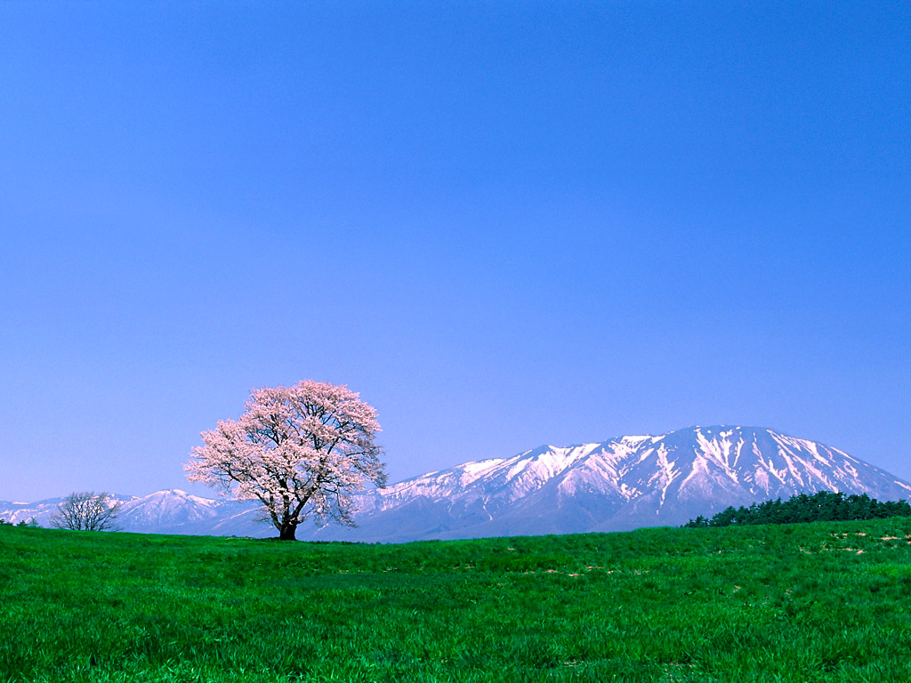
Subfields of Ecology
Community Ecology
Ecosystem Ecology
Deals with all the interacting species in a community; focuses on how interactions affect community structure and organization
Community: consists of all the organisms of all the species that inhabit a particular area (assemblage of populations of many different species)
Emphasizes energy flow and chemical cycling among the various biotic and abiotic elements
Ecosystem: consists of all the abiotic factors plus the entire community or communities of species that exist in a certain area

Slide 8
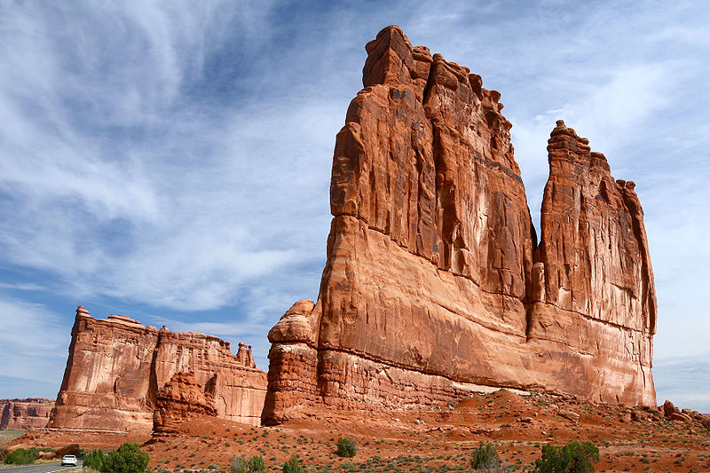
Subfields of Ecology
Landscape Ecology
Deals with arrays of ecosystems, and how they are arranged in a geographic region
Research focuses on factors controlling exchanges of energy, materials, and organisms among ecosystem patches

Slide 9
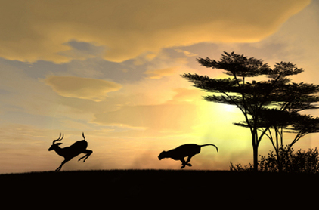
Biosphere
The global ecosystem; the sum of all the planet’s ecosystems
- Broadest area of ecology -
includes every area on
Earth that is inhabited by life

Slide 10
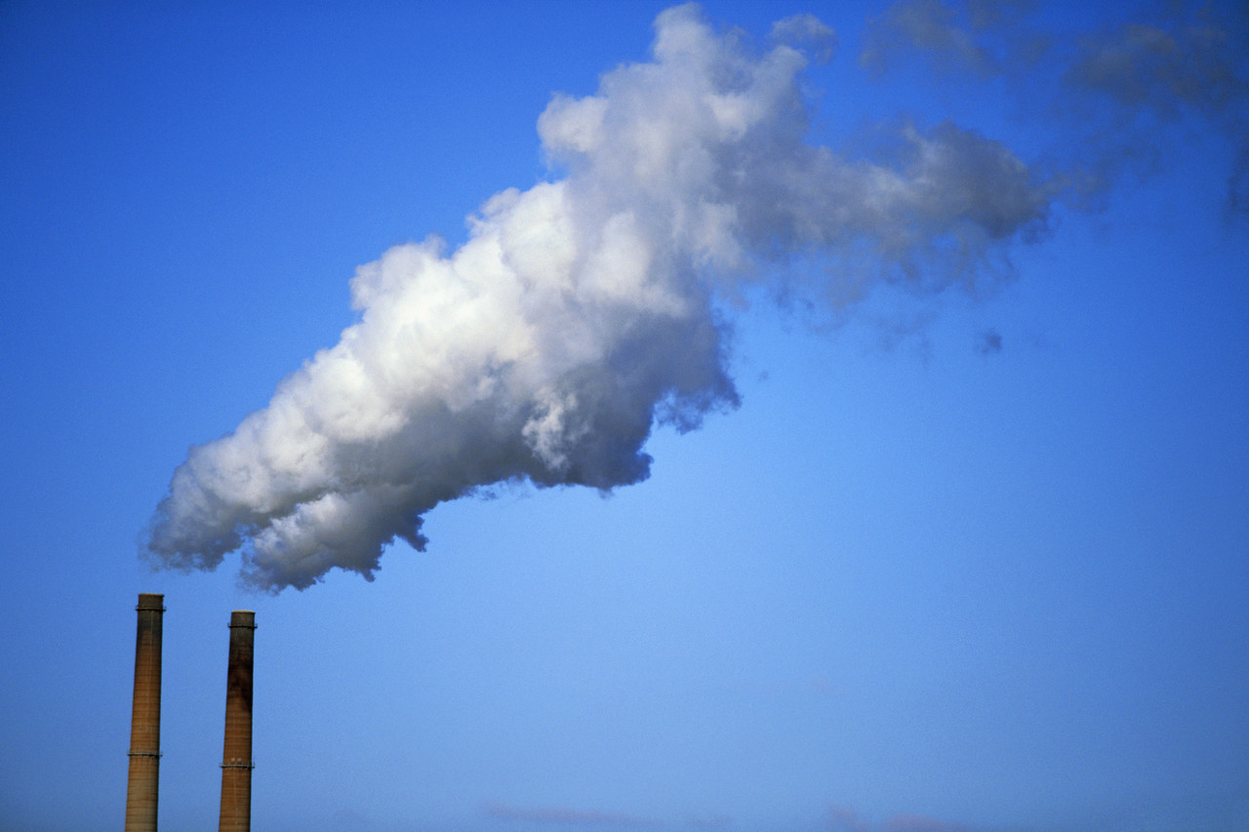
Ecology and the Environment
Misconception that ecology is related to environmental issues
Environmentalism
Ecology’s understanding of relationships and interactions (positive or negative) help solve environmental issues
Acid rain, land misuse, population growth, toxic waste in soil and streams, extinction rates rising because of habitat destruction
- Precautionary Principle

Slide 11
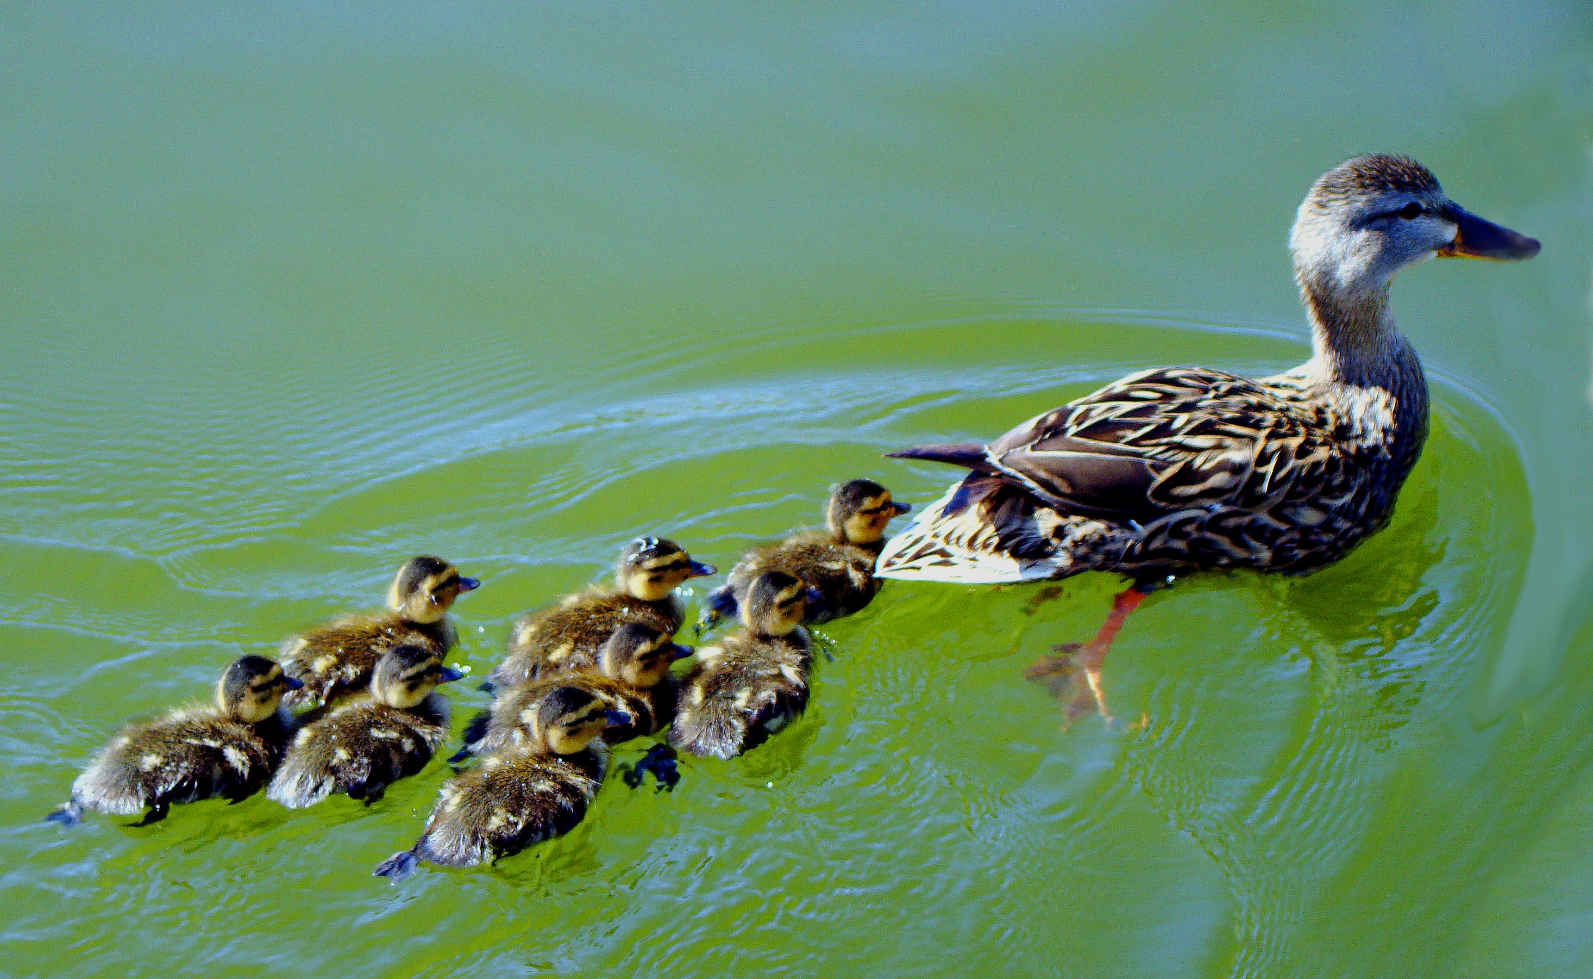
Biogeography
Study of the past and present distribution of individual species, in the context of evolutionary theory
Relationships between the global/regional patterns and the distribution
of organisms
Biogeographic Realms

Slide 12
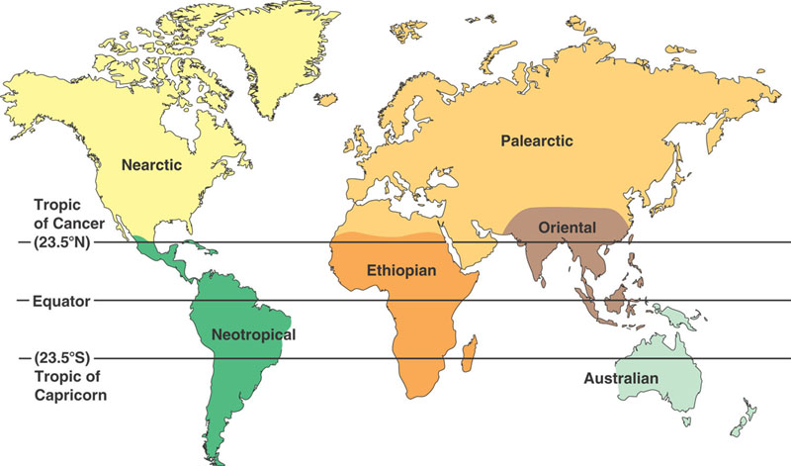

Slide 13
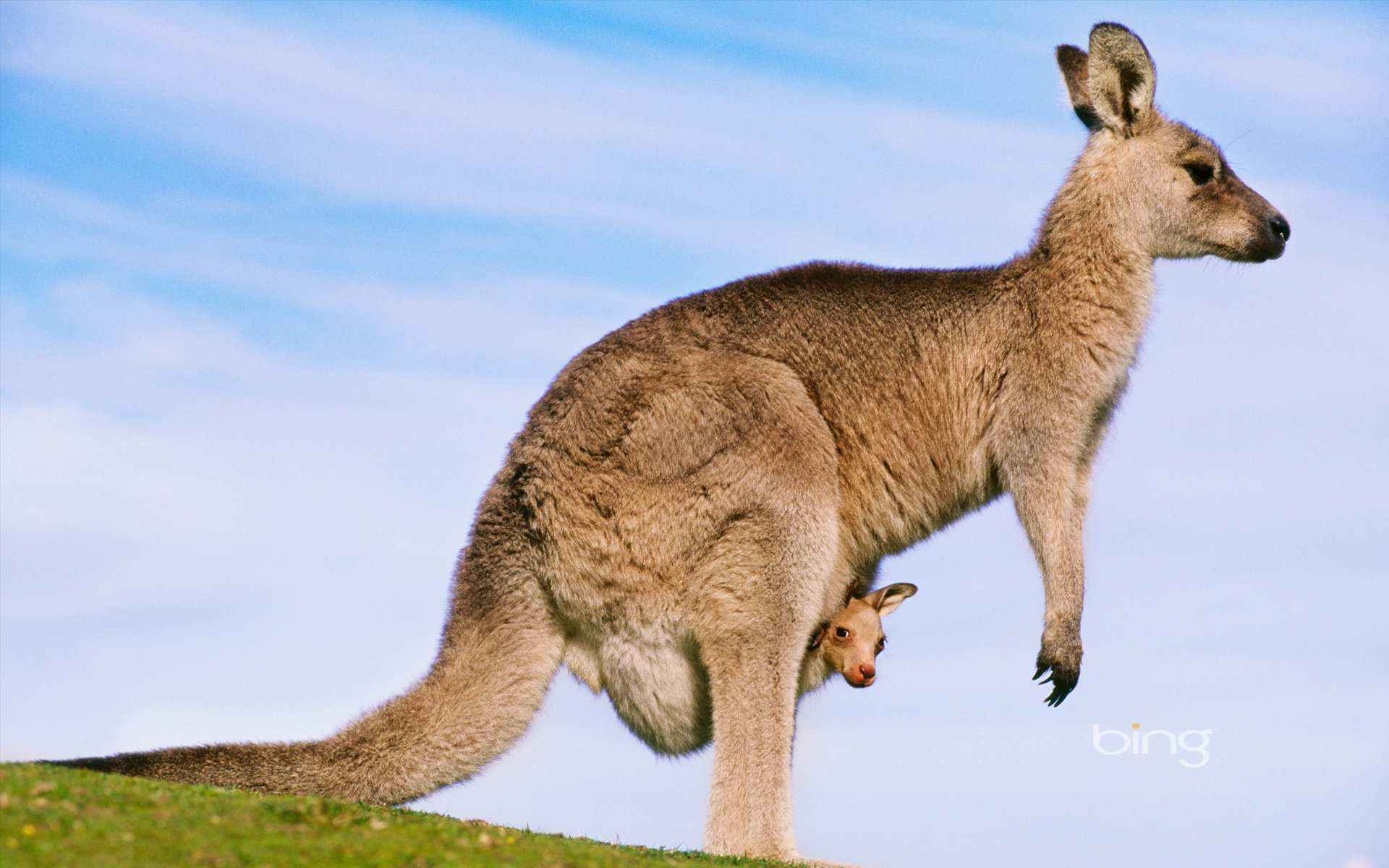
Dispersal and Distribution
- Dispersal: the movement of individuals away from
centers of high population density or from their area
of origin (directly related to distribution)
Ex. Why are there no kangaroos
in North America?
Geographic Isolation
Show influence of
dispersal on distribution
Very rare; turn to
experimentation

