Slide 1
Biological and Geographical Processes Move Nutrients Between Organic and Inorganic Parts of the Ecosystem
Concept 54.4
By Nida Ahmed

Slide 2
Chemical elements are only available in limited amounts.
The recycling of chemical elements is important for life on Earth.

Slide 3
Chemical Cycling
Biogeochemical cycles- Nutrient circuits that involve both biotic and abiotic components of ecosystems
Two general categories of biogeochemical cycles: global and regional.
Global: When gaseous forms of carbon, oxygen, sulfur, and nitrogen occur in the atmosphere
Local: Elements that are less mobile in the environment, such as phosphorus, potassium, calcium, and trace elements
Soil is the main source of these elements.

Slide 4
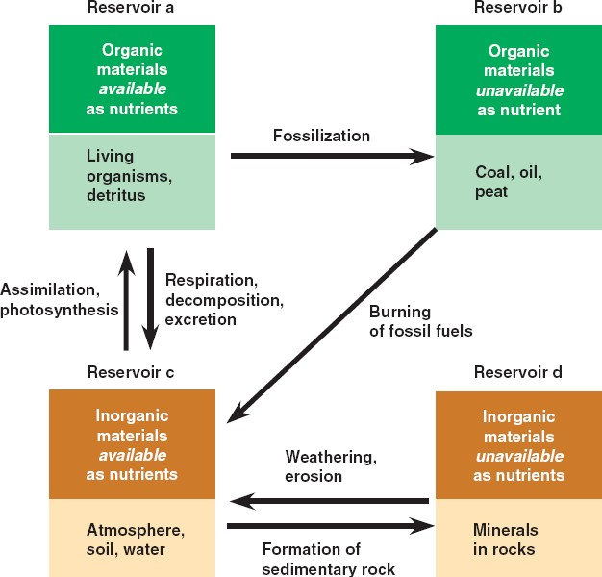
Nutrient Cycling

Slide 5
There are several important biogeochemical cycles such as the water cycle, the nitrogen cycle, the carbon cycle, and the phosphorus cycle.

Slide 6
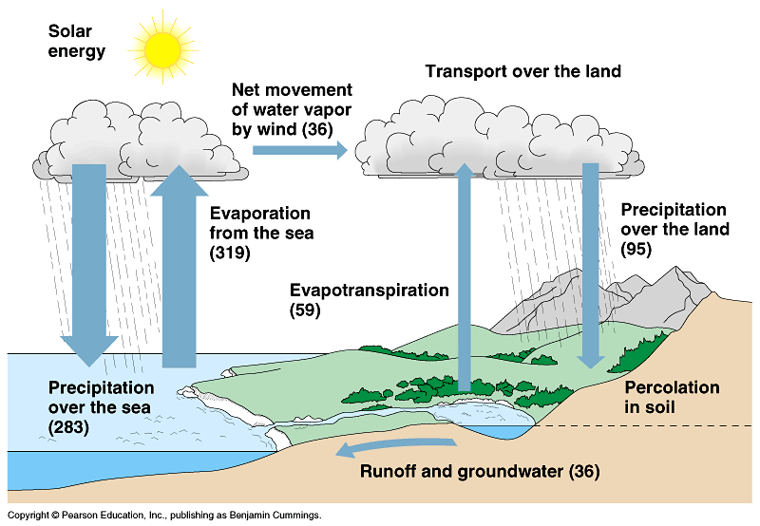
The Water Cycle
Water is needed for all organisms. It also influences the rates of ecosystems processes.
The oceans contain 97% of the water in the biosphere.
2% is bound as ice, and 1% is in lakes, rivers, and groundwater.
Evaporation of liquid water by the sun, condensation of water vapor into clouds, and precipitation.
Transpiration by plants moves significant amounts of water.
Surface flow returns water to the oceans.

Slide 7
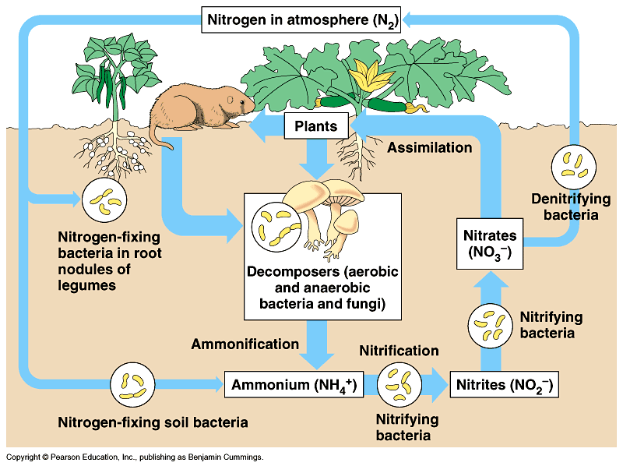
The Nitrogen Cycle
Nitrogen is a component of amino acids, proteins, and nucleic acids. It can also be a limiting plant nutrient
Plants and algae can use ammonium or nitrate .
Animals can use only organic forms of nitrogen.
Nitrogen is in soils and the sediments of lakes, rivers, and oceans.
Nitrogen enters ecosystems through bacterial nitrogen fixation.
Ammonification by bacteria decomposes organic nitrogen.
In nitrification, bacteria convert Ammonia to Nitrate
In denitrification, bacteria use Nitrate for metabolism instead of instead of oxygen releasing nitrogen gas.

Slide 8
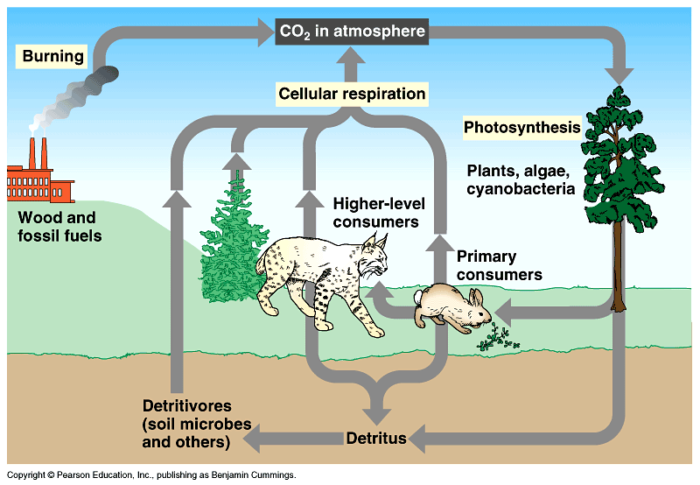
The Carbon Cycle
Carbon forms a framework for the organic molecules.
Autotrophs convert carbon dioxide to organic molecules that are used by heterotrophs.
The major reservoirs of carbon include fossil fuels, soils, aquatic sediments, the oceans, plant and animal biomass, and the atmosphere.
Photosynthesis by plants and phytoplankton fixes atmospheric CO2.
CO2 is added to the atmosphere by cellular respiration of producers and consumers.

Slide 9
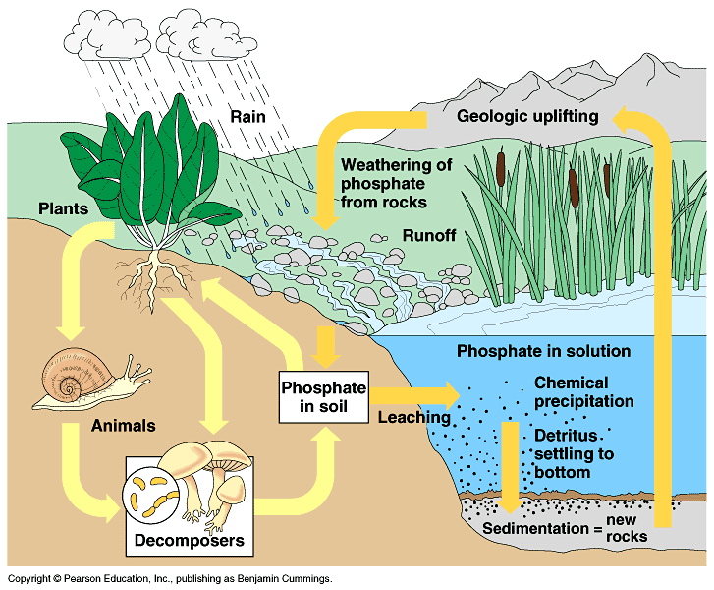
The Phosphorus Cycle
Phosphorus is a component of nucleic acids, phospholipids, and ATP and other energy-storing molecules.
PO₄ᵌ- (phosphate) is the only important inorganic form of phosphorus
The major reservoir of phosphorus is sedimentary rocks of marine origin.
Weathering of rocks gradually adds phosphate to soil.
Phosphate may be taken up by producers and incorporated into organic material.
It is returned to soil or water through decomposition of biomass or excretion by consumers.

Slide 10
Decomposition and Nutrient Cycling
The rates at which nutrients cycle in different ecosystems are extremely variable as a result of variable rates of decomposition.
Temperature and the availability of water affect rates of decomposition and the nutrient cycling times.
the rate of decomposition increases with actual evapotranspiration (the process where water is transferred from the land to the atmosphere by evaporation from the soil).
In aquatic ecosystems, decomposition in anaerobic mud can take 50 years or more.

Slide 11
Vegetation and Nutrient Cycling
Nutrient cycling is strongly regulated by vegetation.
Long-term ecological research (LTER)-led by Herbert Bormann and Gene Likens- monitors the dynamics of ecosystems over long periods of time.
The Hubbard Brook Experimental Forest, a deciduous forest with several valleys, each drained by a small creek has been studied since 1963.
The team determined that internal cycling in a terrestrial ecosystem preserves most of the mineral nutrients.

Slide 12
…Continued
Soon after, some areas were completely logged and then sprayed with herbicides for three years to prevent regrowth of plants.
Water runoff from the altered watershed increased by 30–40% because there were no plants to absorb and transpire water from the soil.
This study showed that the amount of nutrients leaving an intact forest ecosystem is controlled by the plants.

Slide 13
THE END

