Slide 1
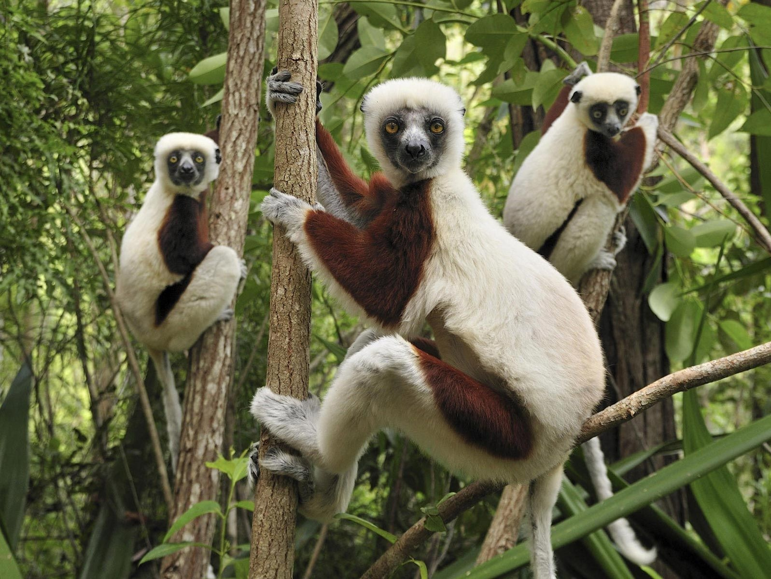
Ecology
Species Transplants – Abiotic Factors
Pages 1084 – 1087
Abbey Burke

Slide 2
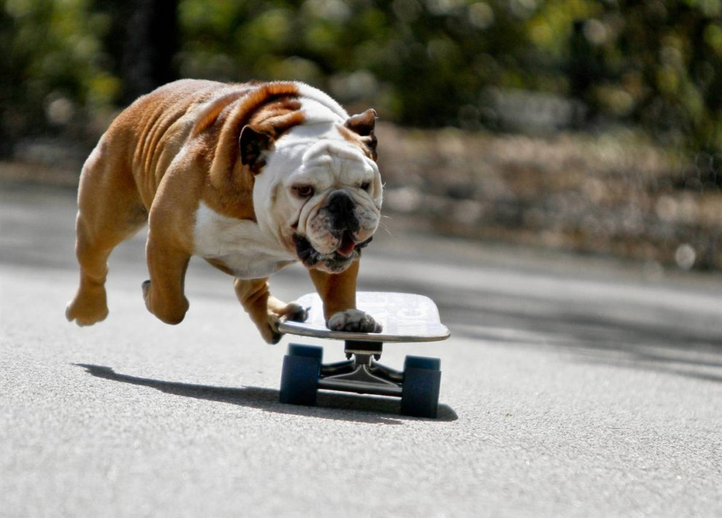
Species Transplants

Slide 3
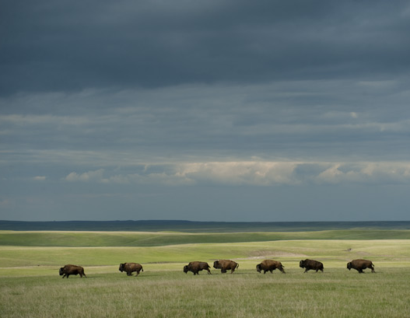
Species Transplants – What?
The process of measuring dispersal and distribution movement through observing the movement of a species to new areas where the species did not previously live

Slide 4
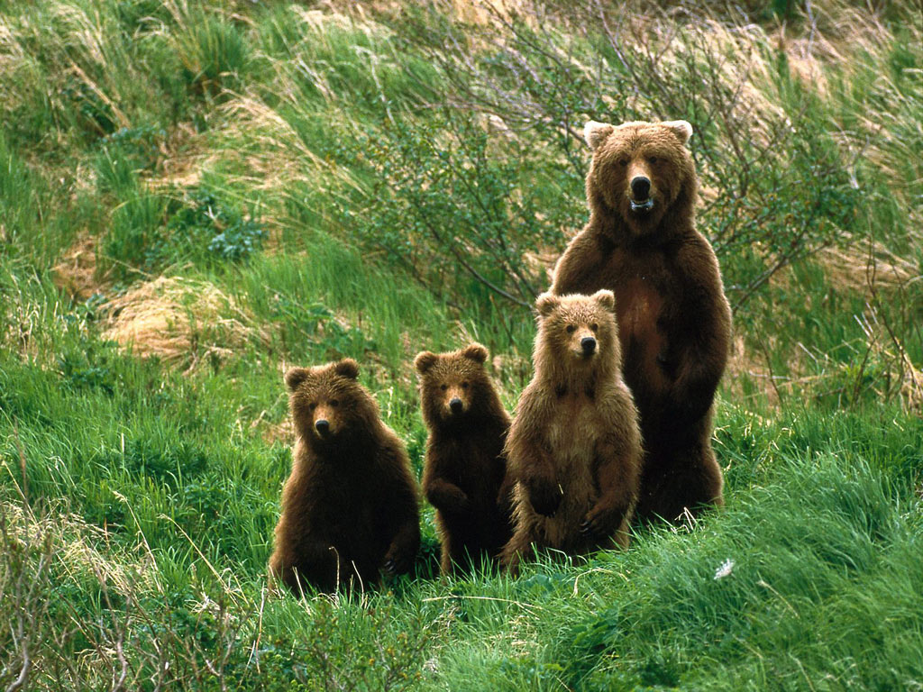
Species Transplants – How?
Scientists observe AND conclude the success of the movement of a species by:
Studying survival
Studying reproduction

Slide 5
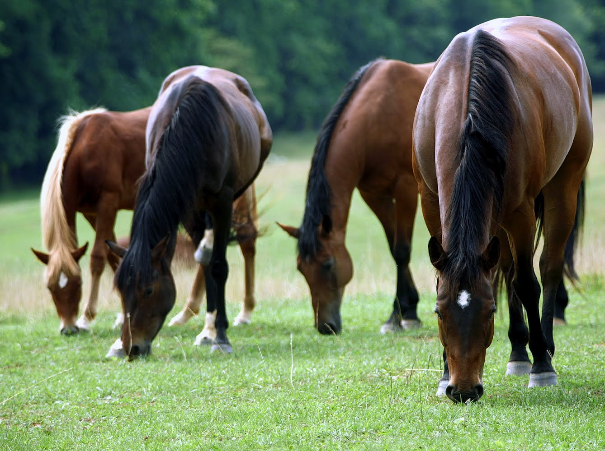
So, what if a species transplant is concluded successful…?
Potential range of the species is higher than its actual range
A species could live in habitats other than their native one

Slide 6
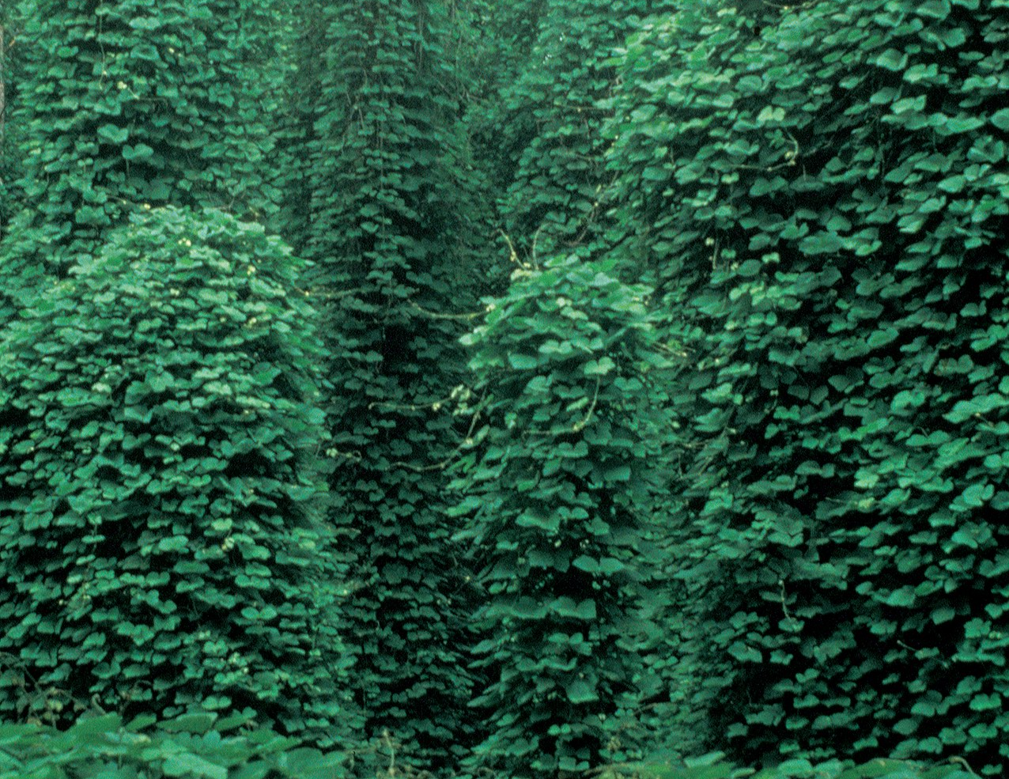
Species Transplants – Problems
Introduced species often disrupt communities and ecosystems that they are introduced to
May spread beyond desired boundaries

Slide 7
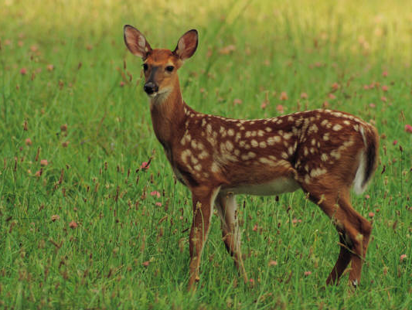
Species Transplants vs. Today
Due to the possible problems species transplants can cause, today Scientists document transplanted species introduced for other purposes
Ex. Game Animals; accidental transplant

Slide 8
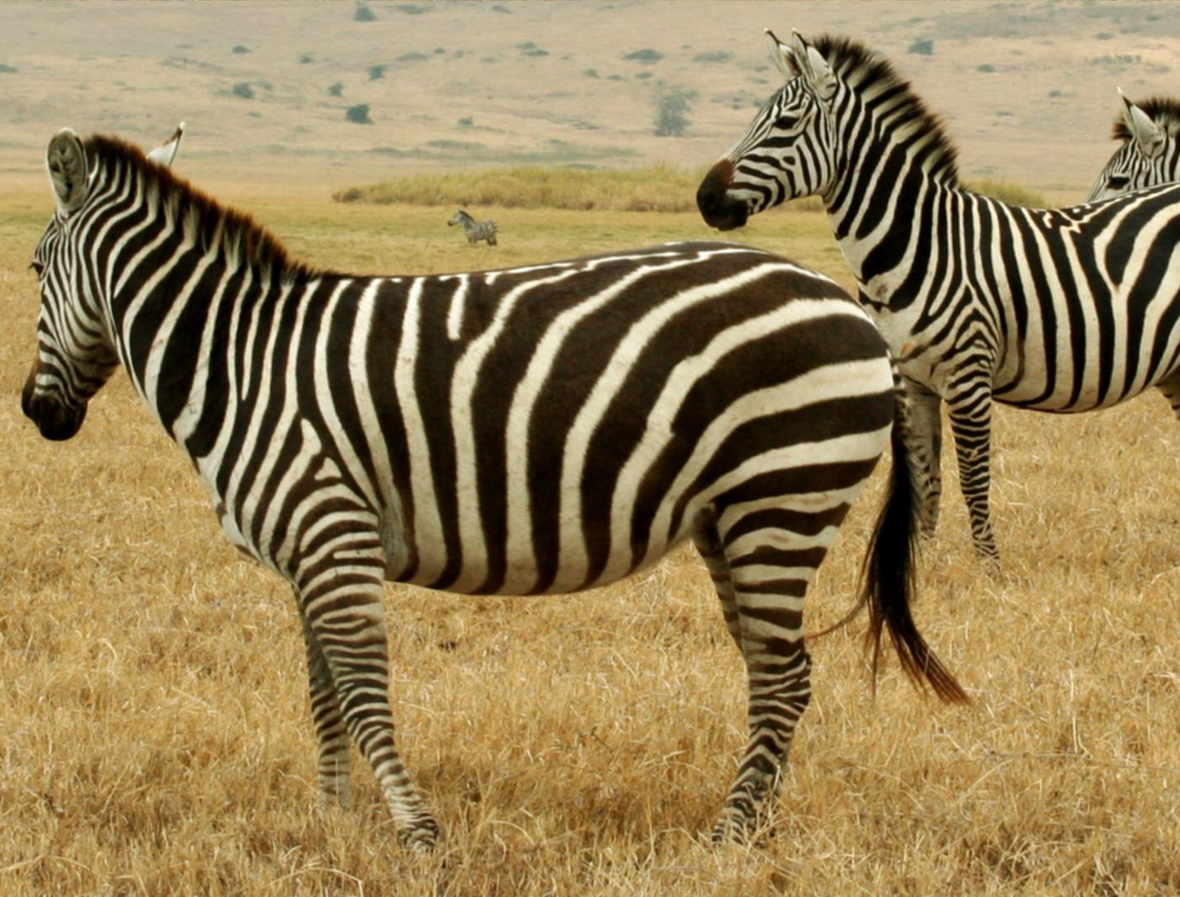
Behavior
and Habitat Selection

Slide 9
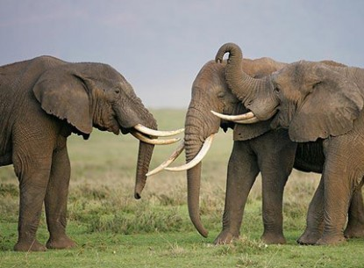
Behavior Selection
Occurs when organisms CAN live in the new environment, yet choose not to
Potential range not fully occupied

Slide 10
If behavior limits distribution…

Slide 11
Habitat Selection
Animals and plants!
Avoid certain habitats
Example: Female insects only deposit eggs under certain stimuli conditions

Slide 12
If behavior does not limit distribution…

Slide 13
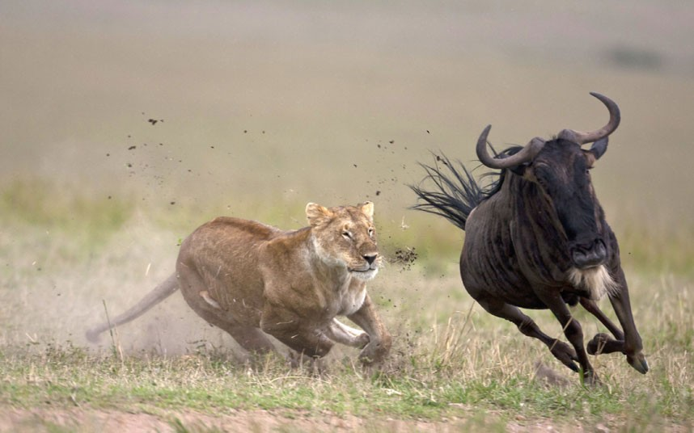
Biotic Factors
Living factors (affected by other species)
Unable to survive or reproduce due to negative interactions with other species through:
Predation
Parasitism
Disease
Competition

Slide 14
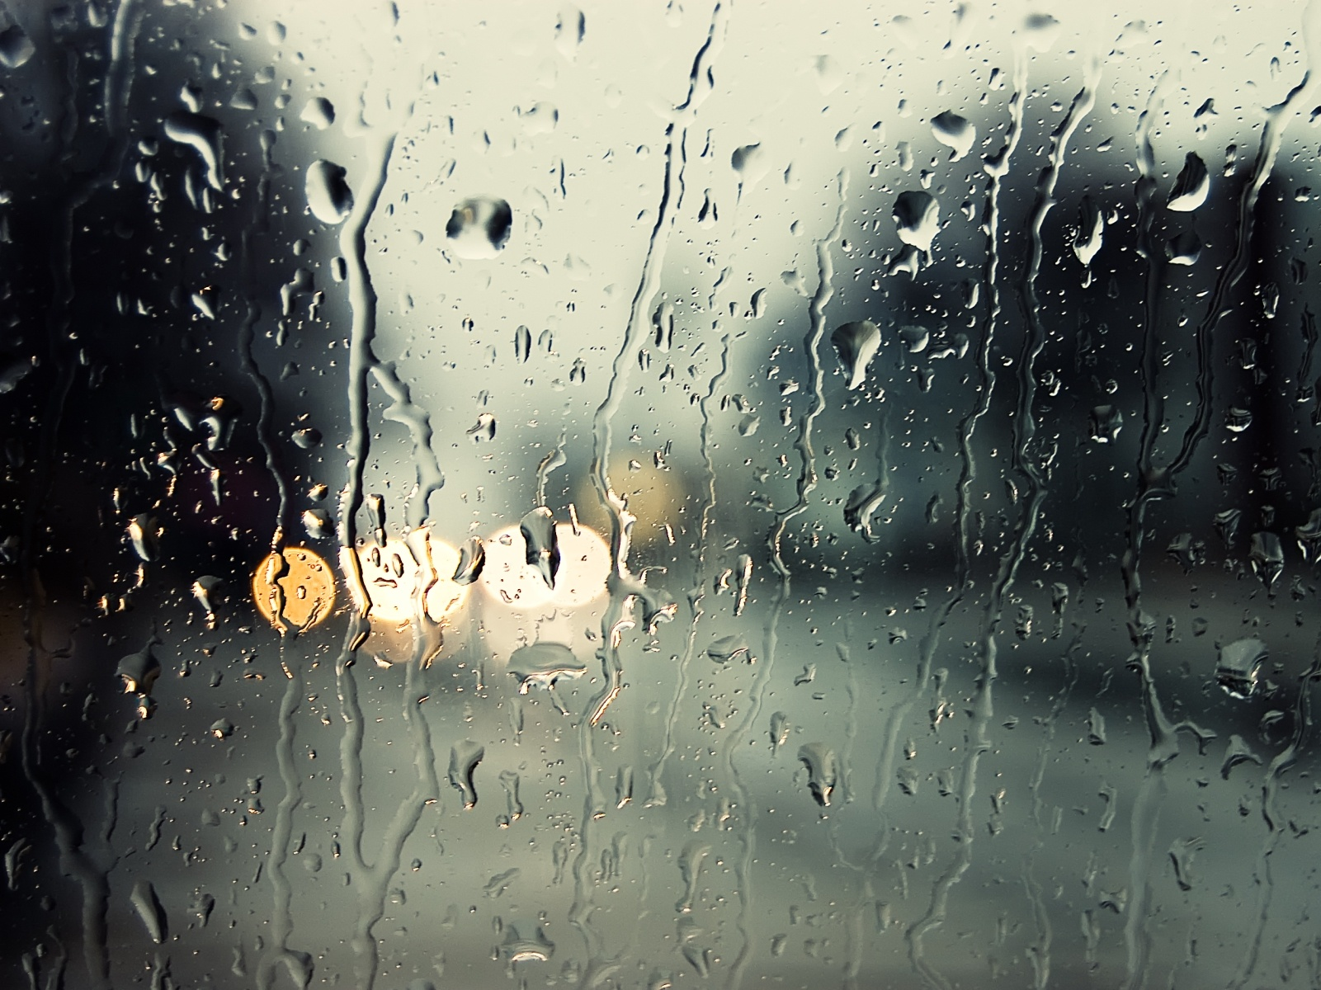
Abiotic Factors
Nonliving factors
Differences in:
Temperature
Water
Sunlight

Slide 15
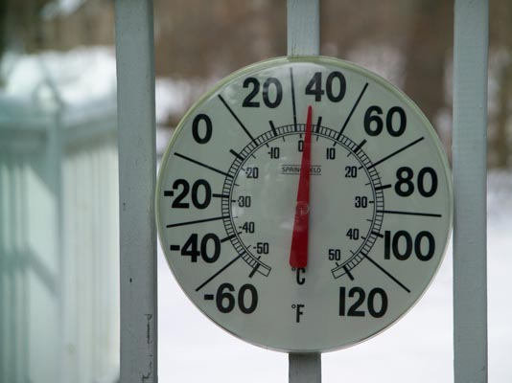
Temperature
Affects biological processes
Cellular rupture
Denaturation of proteins
Metabolism maintenance
Maintaining internal temperature

Slide 16
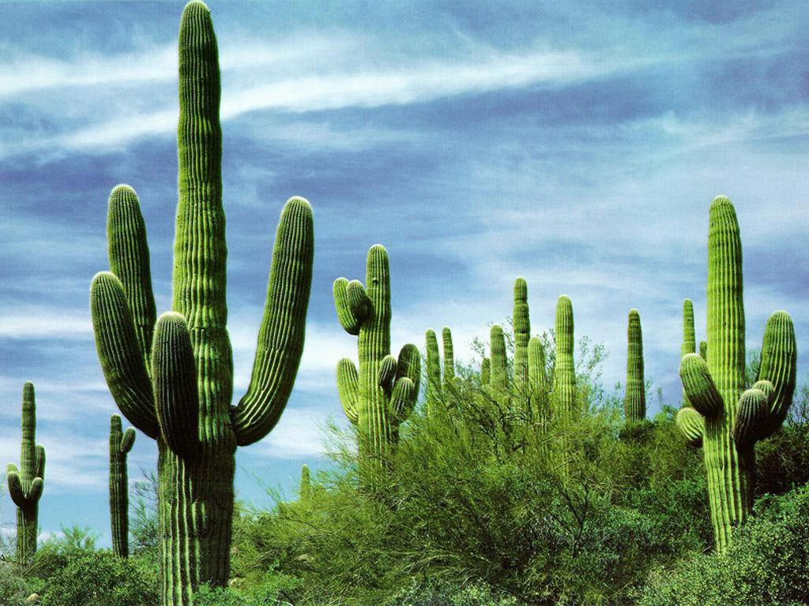
Water
Freshwater vs. Saltwater
Conservation of water
Desert organisms

Slide 17
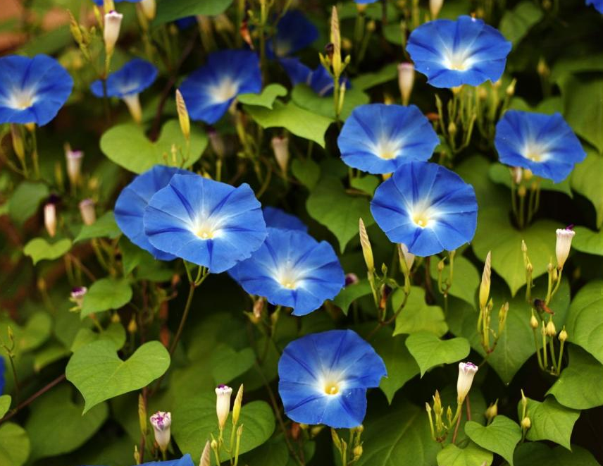
Sunlight
Photosynthesis
Aquatic environments
Affects photoperiod: lengths of daytime and nighttime
Seasons: flowers or migration

Slide 18
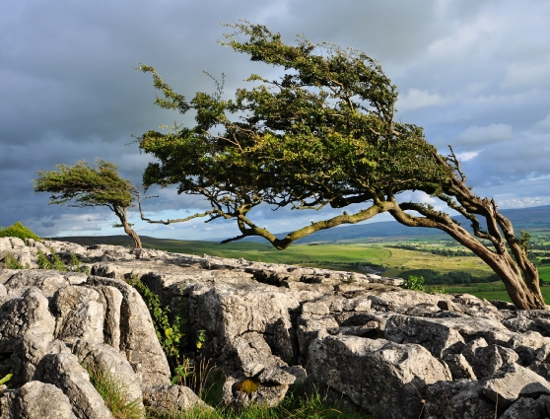
Wind
Increases heat loss due to evaporation and convection
Increases water loss by increasing the rates of:
Evaporative cooling in animals
Transpiration in plants
Morphology of plants

Slide 19
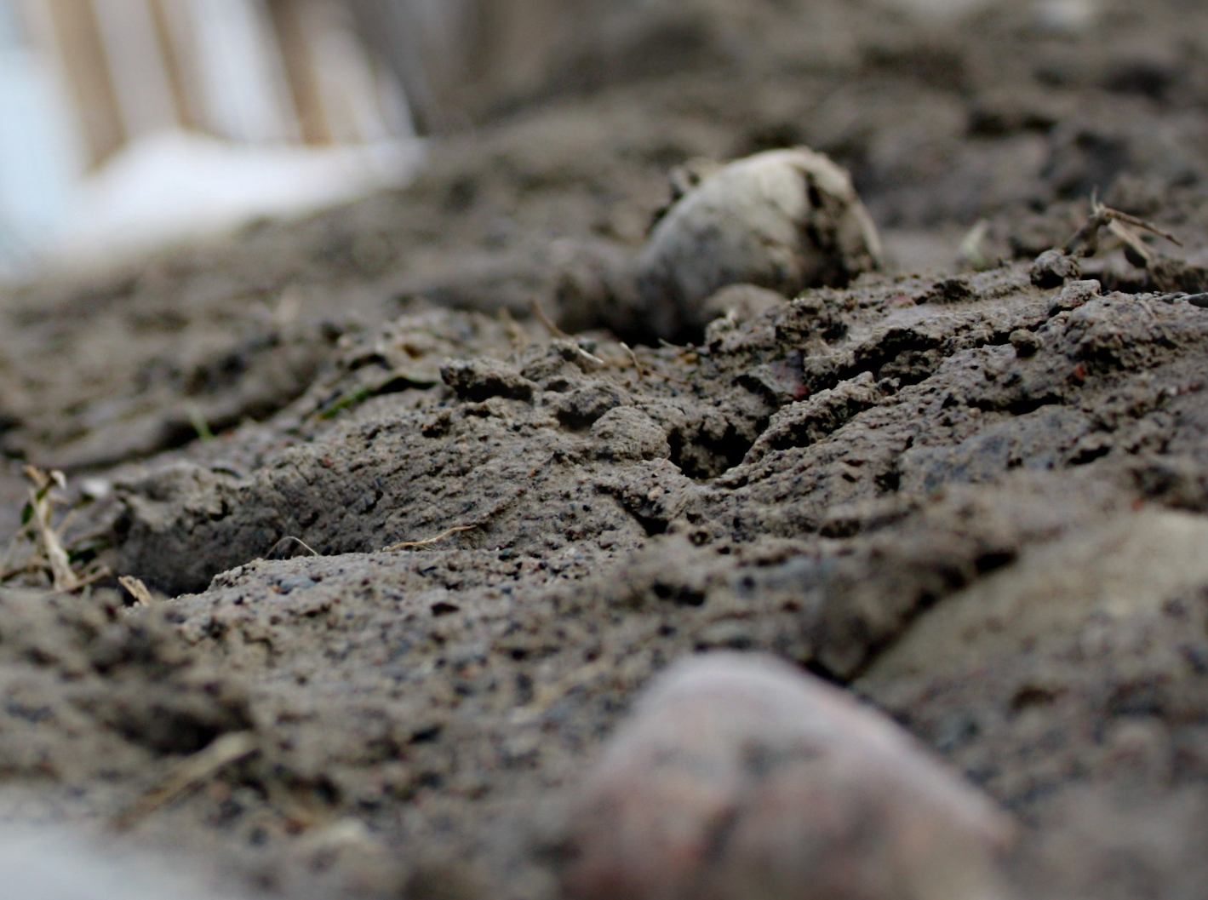
Rock and Soil
Physical structure, pH, and mineral composition limit the distribution of plants, which affects the animals that feed on them
Substrate compositions influences resident organisms

