Slide 1
Climate
By: Elew
Period: 2

Slide 2
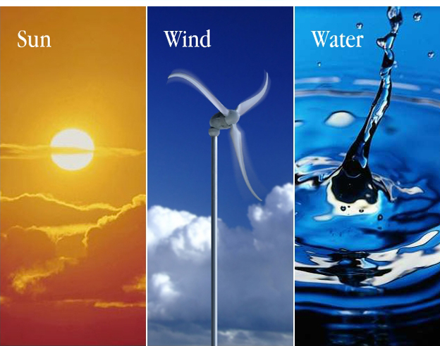
Climate
the prevailing weather conditions in an area
made up off 4 abiotic factors -temperature, water, sunlight , and wind

Slide 3
Climate
these factors have influence on the distribution of organisms.
Macroclimate- weather patterns on global, regional and local level
Microclimate-very fine patterns like ones organisms will find under log

Slide 4
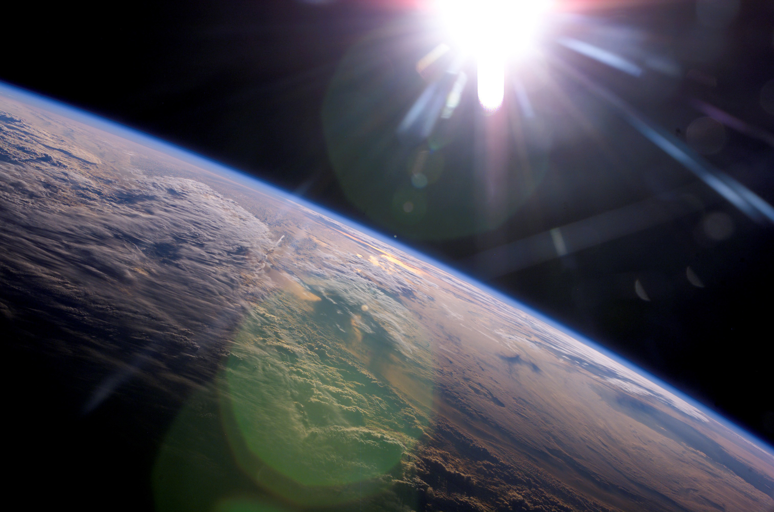
Global Climate patterns
Earths global climate is influenced by planets movement and solar energy
-Sun warms land oceans and causes cycles of air movement and evaporation, causing variations in latitudinal climate

Slide 5
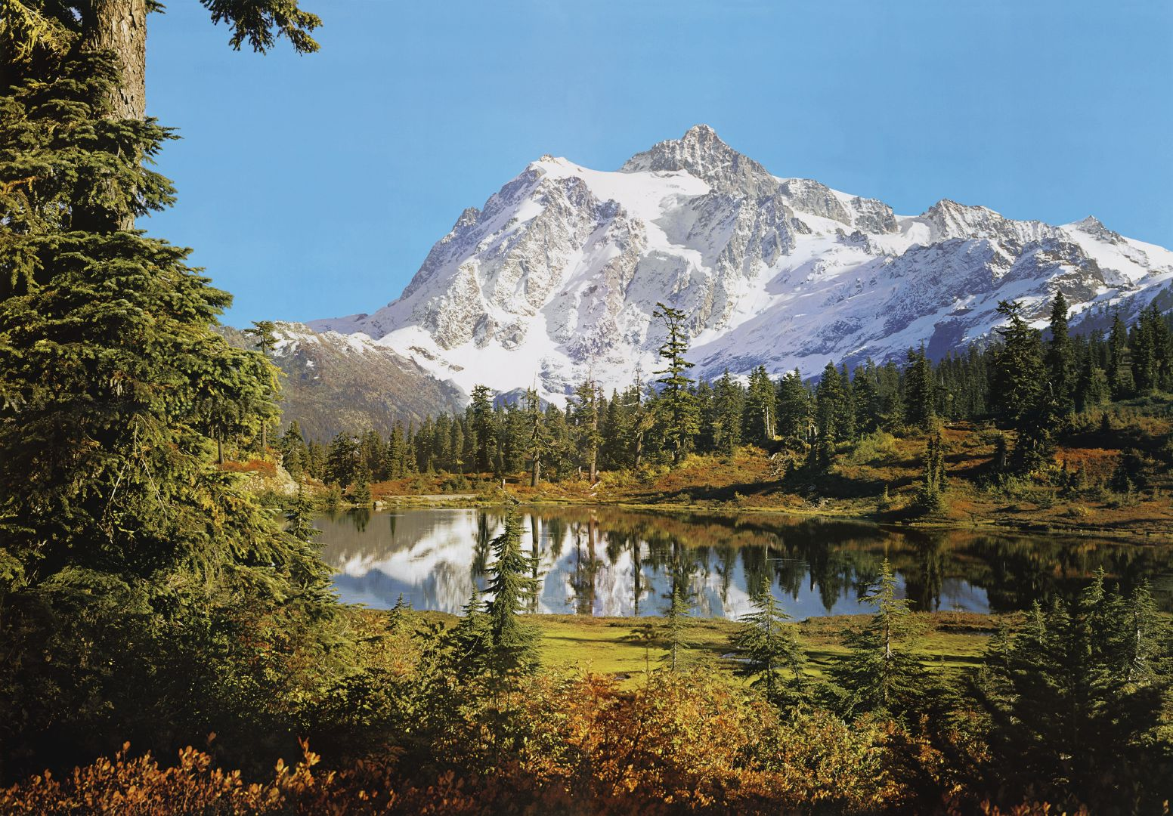
Regional, Local , and Seasonal effects on climate
There are regional and local variations that cause climate "patchiness" in biosphere
-mountains, bodies of water ,seasons

Slide 6
Bodies of water
Ocean currents also influence climate along coasts of continents by heating or cooling air masses which meet the land.
-coastal regions tend to me more moist then inland

Slide 7
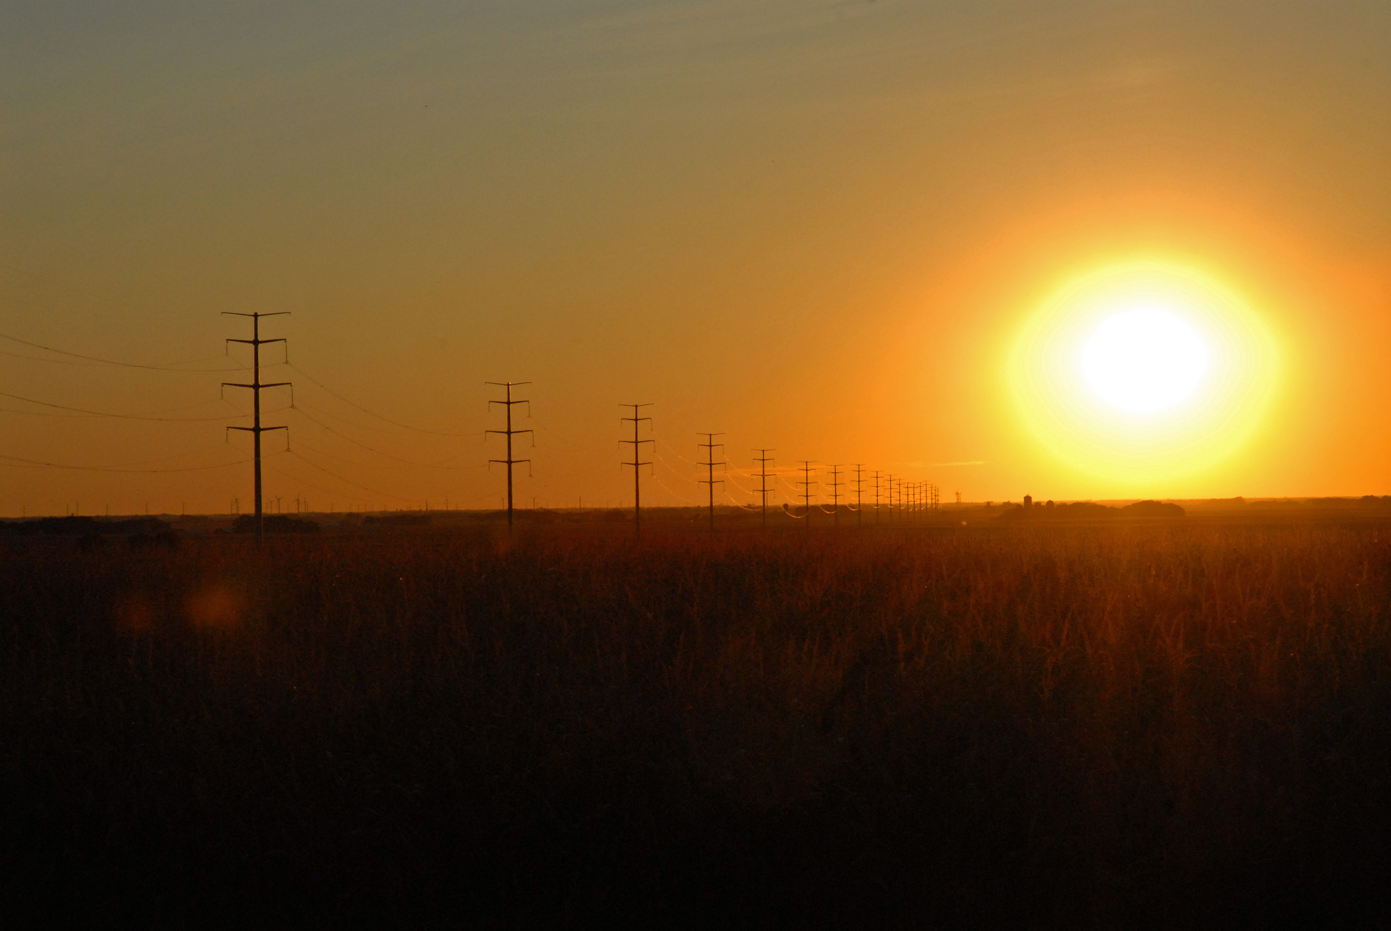
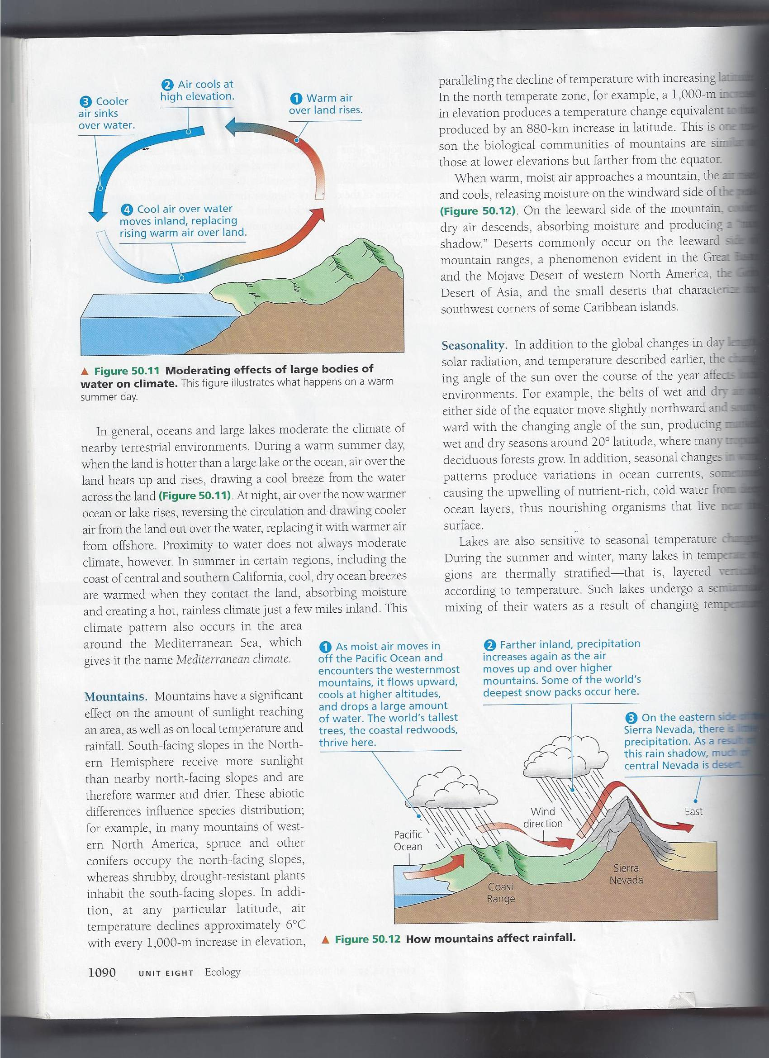
Picture 50.11

Slide 8
Bodies of water
-proximity to water doesn’t always moderate climate though.
- in places like southern California it just absorbs the heat and causes hot weather inland.

Slide 9
Mountains
Mountains effect amount of sunlight reaching area as well as temperature and rainfall
-those with more exposure tend to be drought resistant
-air temp declines 6˚ Celsius with every 1000 m

Slide 10
MOUNTAINS figure 50.12

Slide 11
Seasonality
Seasonal changes in wind patterns produce variations in ocean currents
Turnover- brings oxygenated water from a lakes surface to the bottom and nutrient rich water from the bottom to the surface in spring and autumn.

Slide 12
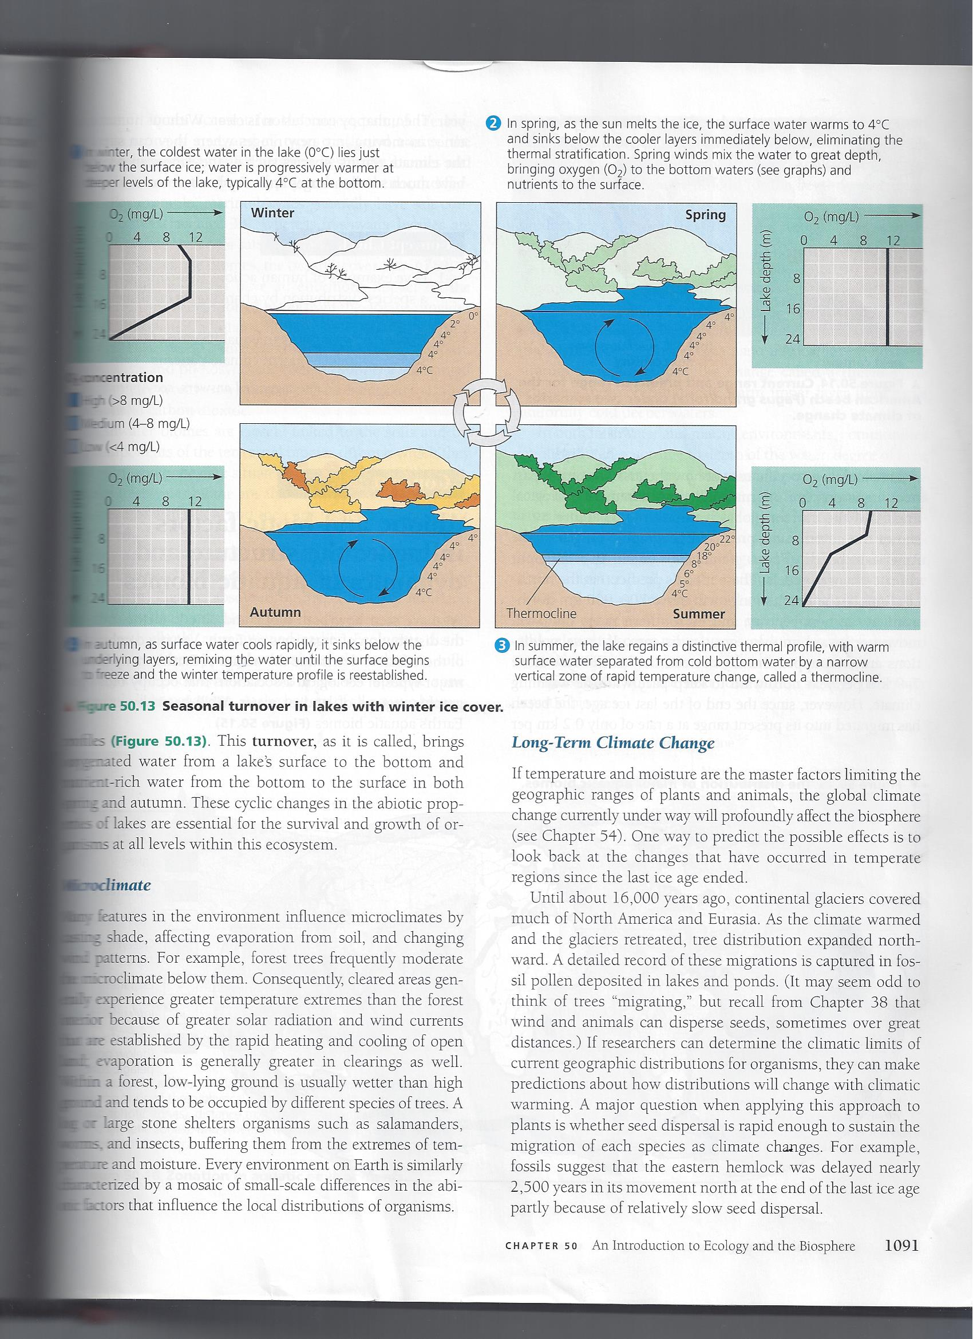
SEASONALITY figure 50.13

Slide 13
Seasonality
Earth has a tilt of 23.5˚ it causes seasons.
This causes the tropics to have the longest annual exposure to the sun and least change in seasonal climate.

Slide 14
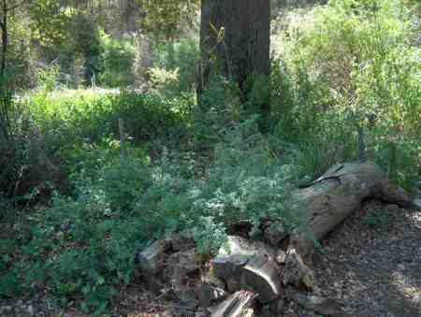
Microclimate
Forest trees effect micro climate
-Things like logs shield animals such as salamanders, worms and insects from temperature.

Slide 15
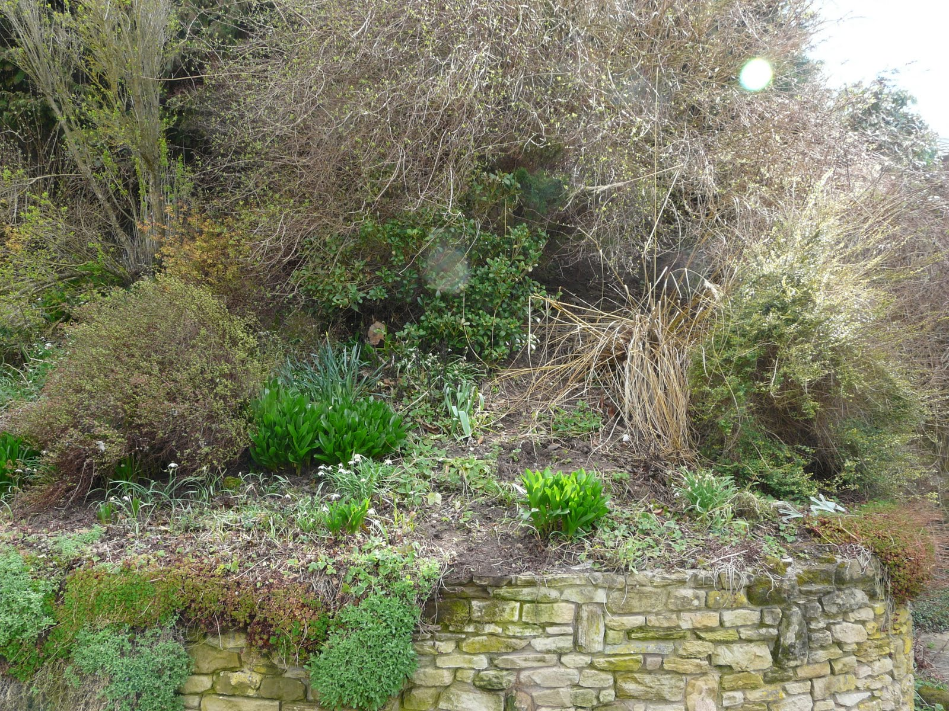
Long term climate change
Changing temperature in the future can change the plants and animals living in certain regions
-some animals wont survive in the changing temperatures ,can cause extinction and species will have smaller concentrations

Slide 16
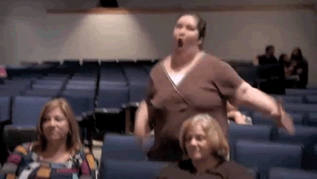
The End

