Slide 1
Ecology
Kelsey Brown
AP Biology

Slide 2
Biomes
Major types of ecological associations that occupy broad geographic regions of land or water
Aquatic biomes account for the largest part of the biosphere in terms of area
Notes:
Say: The different types of biomes are determined by both biotic and abiotic factors

Slide 3
Aquatic Biomes
Marine
Freshwater
Salt concentration of about 3%
Cover about 75% of the Earth’s surface
Huge Impact on:
Rainfall
Climate
Wind patterns
Algae and Photosynthetic bacteria supply oxygen and remove Carbon Dioxide
Salt concentration of less than 1%
Influenced by patterns and speed of water flow and climate of the biome
Notes:
- Biologists distinguish between freshwater and marine biomes on the basis of physical and chemical differences
Largest Marine Biomes are the oceans and the evaporation of the ocean provides most of the planet’s rainfall
Examples of Freshwater are lakes, streams, rivers, and wetlands

Slide 4
Stratification of Aquatic Biomes
Separation into layers
Photic Zone: where there is sufficient light for photosynthesis
Aphotic Zone: where little light penetrates
Benthic Zone: bottom of all aquatic biomes
Benthos: communities of organisms that live in the benthic zone
Feed on Detritus which is dead organic matter
Notes:
-Light intensity decreases as you get deeper into the water so the area where there is enough light for photosynthesis is called the the photic zone and vise versa for the other zone
-Benthic zone is made up of sand and inorganic and organic sediments
-Deepest regions of ocean floor are known as the abyssal zone

Slide 5
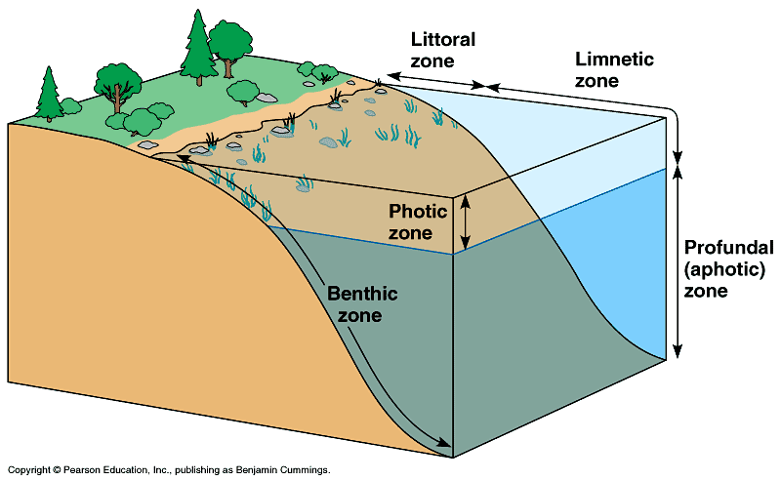
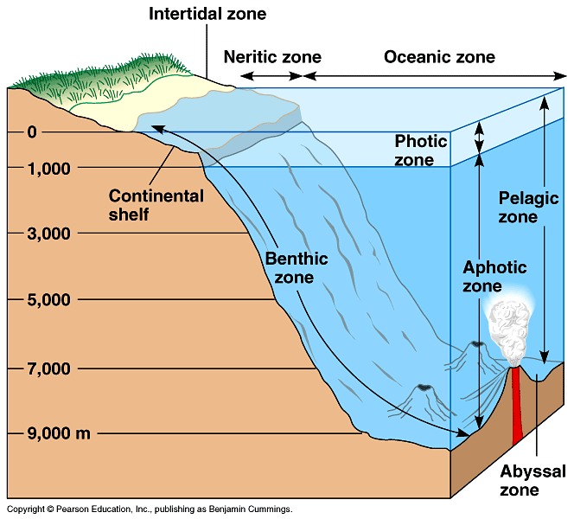
Notes:
Top: Freshwater Biomes
Bottom: Marine BIomes

Slide 6
Thermal Stratification
Thermal energy from the sun warms surface waters to whatever depth it penetrates
Deeper surfaces remain cold
Water in lakes tends to be stratified
Thermocline: a narrow stratum of rapid temperature change
Notes:
Lake stratification is exaggerated during the summer and winter
Result of this stratification is a thermocline– explain that if you think about it you swimming like down down down...it’d be the area with a greater temperature difference than the others

Slide 7
Communities in Aquatic Biomes
Communities are distributed according to
Depth of water
Degree of light penetration
Distance from shore
Open water vs. Bottom
Notes:
Examples: Phytoplankton must live in an area where the degree of light penetration is good

Slide 8
Imagine a picture of the CHICAGO skyline!

Slide 9
Lakes
Physical Environment
Standing bodies of water
Stratified
Temperature has a seasonal Thermocline
Chemical Environment
Oligotrophic lakes
Eutrophic lakes
Notes:
-Can range from ponds to huge lakes
-Page 1091 in the book shows that like during the summer and winter there is a larger difference in temperatures in the lake which produces the lake but during the spring and fall, the temperatures are more uniform
-Oligotrophic lakes are nutrient-poor, oxygen-rich and a low amount of decomposable organic matter
-Eutrophic lakes are : nutrient-rich, often depleted of oxygen and a high amount of decomposable organic matter
-Oligotrophic lakes tend to have less surface area relative to their depth than eutrophic
-Oligotrophic lakes can become more eutrophic as runoff adds sediments and nutrients to the lake

Slide 10
Lakes
Photosynthetic Organisms
Littoral zone: shallow well lighted water close to shore
Rooted and floating aquatic plants
Limnetic Zone: further away from shore and water is too deep to support rooted plants
Phytoplankton and Cyanobacteria
Animals
Limnetic zone: Zooplankton and Phytoplankton
Benthic zone:variety of invertebrates
Fish live in all zones with sufficient oxygen
Human Impact
Pollution by runoff from fertilized land and dumping waste leads to nutrient enrichment
Causes algal blooms, oxygen depletion and fish kills
Notes:
Rates of photosynthesis are higher in eutrophic lakes than in oligotrophic lakes

Slide 11
Wetlands
Wetland: an area covered with water for a long enough period to support for a long enough period
Very productive biome
Chemical Environment
Water and soils are periodically low in dissolved oxygen
Basin Wetlands: develop in shallow basins ranging from upland depressions to filled-in lakes and ponds
Riverine Wetland: develop along shallow and periodically flooded banks of rivers and streams
Fringe Wetlands: occur along coasts of large lakes and seas
Notes:
Example of Wetland: Okefenokee National Wetland Reserve, swamps, bogs
High organic production and decomposition in wetlands causes them to be low in dissolved oxygen
Fringe Wetlands: water is flowing back and forth because of rising lake levels and tidal action → fringe wetlands are both freshwater and marine wetlands

Slide 12
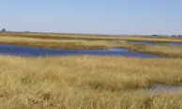
Basin Wetland

Slide 13
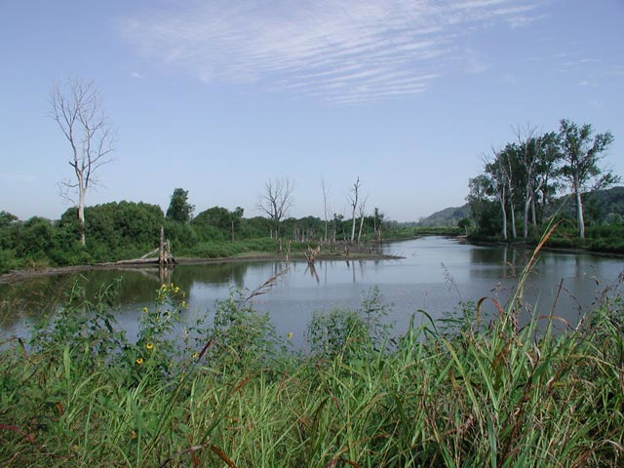
Riverine Wetland

Slide 14
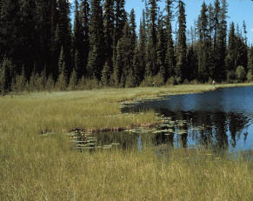
Fringe Wetland

Slide 15
Wetlands
Life in Wetlands
Human Impact
Water saturated soils favor growth of plants like floating pond lillies and cattails
Woody plants dominate swamps
Sphagnum mosses dominate bogs
Home to invertebrates and birds
Herbivores: crustaceans, insect larvae and muskrats
Carnivores: dragonflies, otters, alligators and owls
Draining and filling in the wetlands
Notes:
These plants have adapted so that they can thrive in periodically anaerobic water/soil
Draining and filling has destroyed up to 90% of wetlands in some regions

Slide 16
Picture a stream in Sweden!
Notes:
Picture of a stream in Sweden

Slide 17
Streams and Rivers
Have a current
Headwater Streams: cold, clear, turbulent and swift
Tributaries move downstream and form a bigger river that is warmer and more turbid because of sediment
Stratified vertically (surface water through ground water)

Slide 18
Streams and Rivers
Chemical Environment
Geological Environment
Salt and Nutrient content increases from headwater to the mout
In streams, headwaters are generally rich in oxygen
Rivers are also generally rich in oxygen
Headwater Streams: narrow with a rocky bottom
Downstream reaches of rivers: wide and meandering
River Bottoms: silty from sediments deposited over time

Slide 19
Streams and Rivers
Life Streams and Rivers
Human Impact
Algae
Rooted aquatic plants
Fishes
Invertebrates
Municipal agriculture and industrial pollution degrade water quality and kill organisms
Damming and flood control impair natural functioning and threaten migratory species like salmon
Notes:
Terrestrial vegetation provides most of the food for aquatic consumers

Slide 20
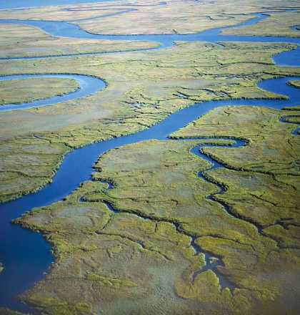
Estuaries
A transition area between river and sea
Mix of salt water and fresh water
Have complex flow patterns
Salinity
Varies within the estuary
Varies according to tides
Very productive
Complex network of tidal
channels, islands, natural
levees and mudflats
Notes:
Like on the Savanna trip

Slide 21
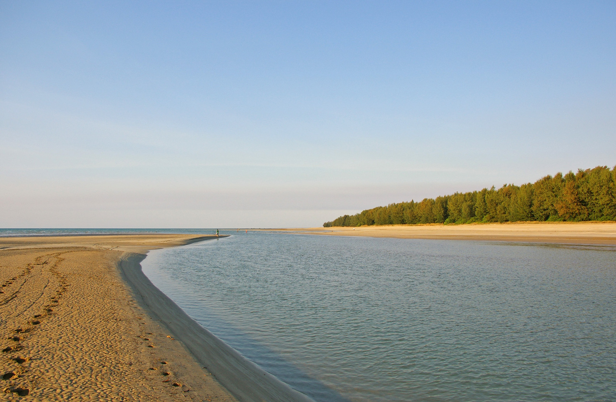
Estuaries
Life in Estuaries
Human Impact
Salt marsh grasses
Algae
Worms
Oysters
Crabs
Fish
Invertebrates
Waterfowl
Pollution from upstream
Filling and Dredging have disrupted estuaries worldwide
Notes:
Often used as mating grounds
Picture is of an estuary in Australia

Slide 22
Intertidal Zones
A zone that is periodically submerged and exposed by the tides, twice daily on most marine zones
Variations in temperature, salinity and mechanical forces of wave action all challenge organisms living in this zone
Oxygen and nutrient levels are generally high and are renewed with each turn of the tides
Generally rocky or sandy

Slide 23
Notes:
Beaches are intertidal zones

Slide 24
Picture a rocky beach on a sunny day!

Slide 25
Intertidal Zones
Life in Intertidal Zones
Human Impact
Zones with rigorous wave action lack attached plants and algae
Sandy intertidal zones in protected bays or lagoons often support rich beds of sea grass and algae
Worms, Clams, Crustaceans
Sponges, Anemones, Mollusks, Echinoderms and small fishes
Oil pollution
Recreational use has caused a large decline in the number of beach-nesting birds and sea turtles
Notes:
Animals sometimes bury themselves in the mud

Slide 26
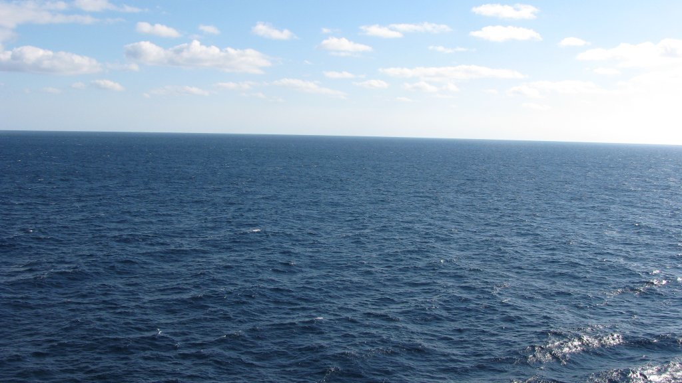
Oceanic Pelagic Biome
Vast realm of open blue water
Surface waters turn over during fall through spring
High oxygen levels
Nutrient levels are generally lower than costal waters
Covers about 70% of Earth’s surface
Average depth is nearly 4,000m
Notes:
Because of higher water clarity, Photic zone extends to greater depths than in costal marine waters

Slide 27
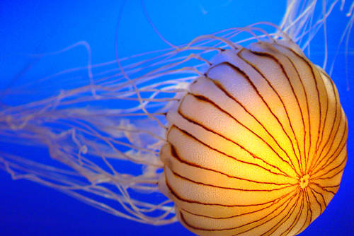
Oceanic Pelagic Biome
Life in the Pelagic Biome
Human Impact
Phytoplankton
Zooplankton
Protozoans and Worms
Copepods and Krill
Jellies
Fish
Free swimming animals like squids, fishes, sea turtles and marine mammals
Overfishing
Pollution by waste dumping and oil spills
Notes:
Depleting fish stocks

Slide 28
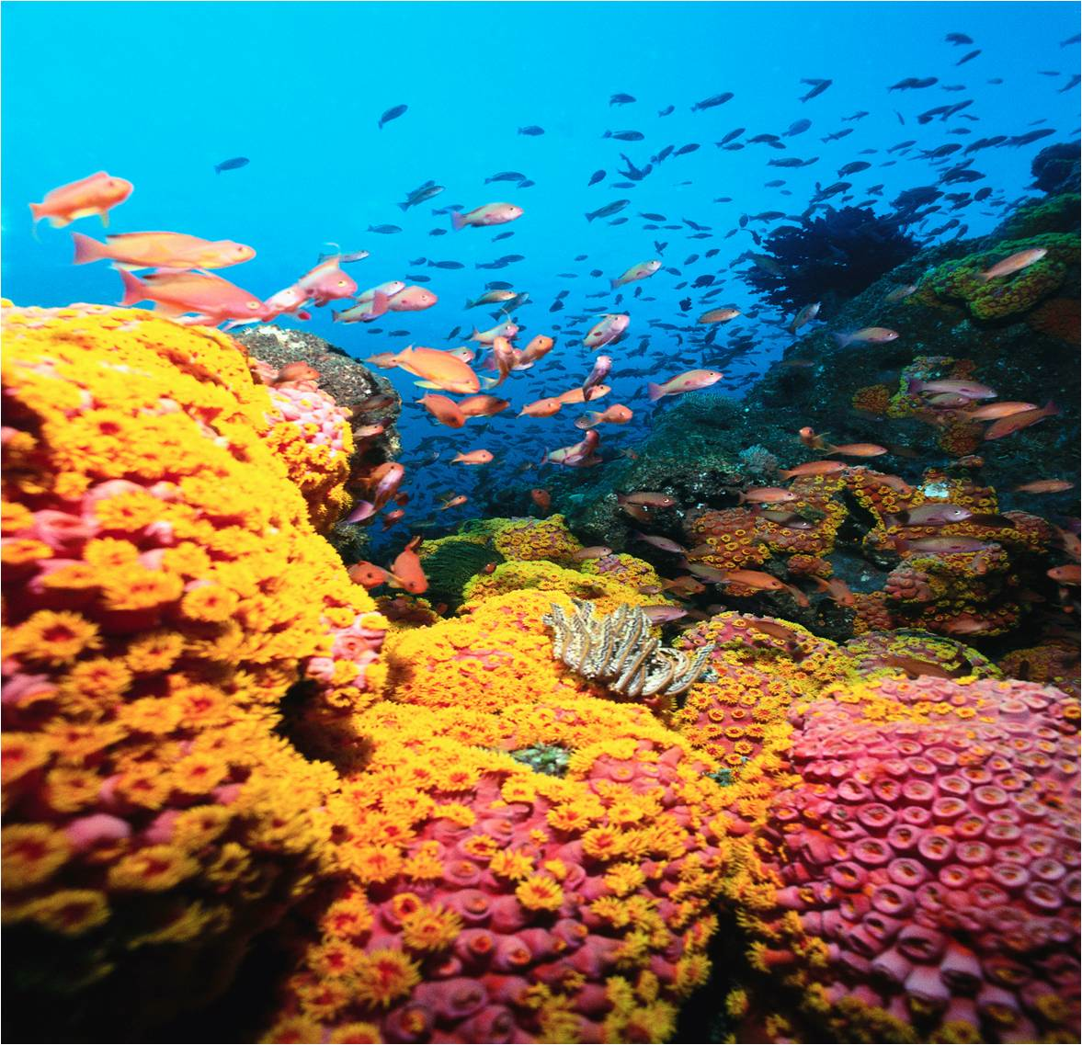
Coral Reefs
Exist in the photic zone of relatively stable tropical marine environments with high water clarity
Temperature sensitive
High oxygen levels
Excluded by high inputs of fresh water and nutrients
Require a solid substrate for attachment
Formed largely from calcium carbonate skeletons of corals
Develops over a long time on oceanic islands
Notes:
They like to stay between about 18 to 30 degrees C

Slide 29
Coral Reefs
Life in Coral Reefs
Human Impact
Unicellular Algae
Multicellular red and green algae
Corals (Cnidarians)
Fishes
Invertebrates
Collecting coral skeletons
Overfishing and using poisons and explosives has reduced populations of corals and reef fishes
Global warming and pollution also contribute to killing coral
Notes:
High diversity of fish and invertebrates

Slide 30
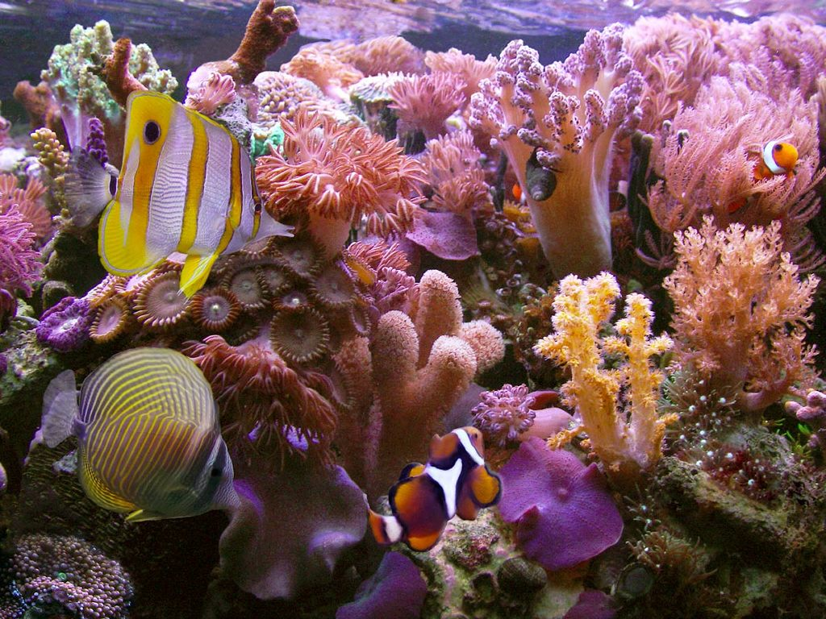

Slide 31
Sources
http://www.zo.utexas.edu/faculty/sjasper/images/50.18.gif
http://tbsecosystemsold.wikispaces.com/file/view/PelagicZoneDiagram.gif/59246702/672x608/PelagicZoneDiagram.gif
http://deq.mt.gov/wqinfo/wetlands/LacustrineFringe.mcpx
http://mo.water.usgs.gov/current_studies/richards/wetlands/images/ebwa.jpg
http://www.fws.gov/refuge/rainwater_basin_wmd/
http://www.nomoresweden.com/wp-content/uploads/stream.gif
http://bio1152.nicerweb.com/Locked/media/ch52/52_18fGeorgiaEstuary-L.jpg
http://upload.wikimedia.org/wikipedia/commons/9/9e/Estuary_mouth.jpg
http://img.ehowcdn.com/article-new/ehow/images/a06/ap/tc/intertidal-zone_-800x800.jpg
http://2.bp.blogspot.com/-jaO3LBzVAn0/ThS_4zl7xkI/AAAAAAAAAPY/1_dZUrOghfg/s1600/Caribbean+Cruise+2007+-+Disney+Magic+-+Open+Ocean+-+Skyline.jpg
http://25.media.tumblr.com/tumblr_l5se7s9ltc1qajqdmo1_500.jpg
http://switchboard.nrdc.org/blogs/fbeinecke/Healthy.coral.reef.No.Title.jpg

