Slide 1
Animal Signals and Communication
Signal- a behavior that causes a change in another animal’s behavior
Communication- transmission, reception and response to signals
Efficient in energy costs
Nocturnal: olfactory and auditory
Diurnal: visual and auditory signals (birds, humans)

Slide 2
Chemical Communication
Pheromones: chemical substances that animals use to communicate
Often relate to reproductive behavior
Important in context
Also, used in non-reproductive behavior
Acts as an alarm substance
Effective at low concentrations

Slide 3
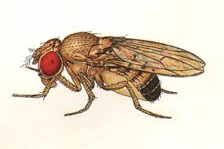
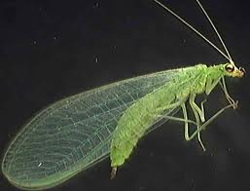
Auditory Communication
Generally under direct genetic control
Male Drosophila raised in isolation produce characteristic song for their species with little variation
Chrysoperla carnea- courtship song divides into 15 species
Hybrids sing song that contains elements of both parental species’ songs

Slide 4
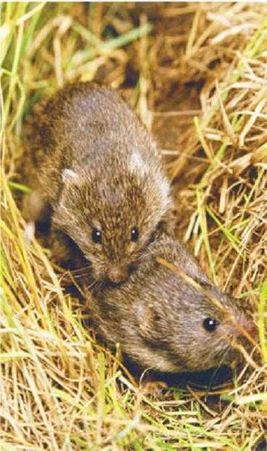
Genetic Influences on Mating and Parental Behavior
Many under strong genetic control
Prairie voles: monogamous, male help care for young
Mated males are aggressive while unmated are non-aggressive
Researches thought arginine-vasopressin (neurotransmitter released during mating) might mediate these behaviors
AVP binds with V_{1a} receptors
These receptors were put in mice and they showed similar mating behaviors
Single gene may mediate a considerable amount of mating behavior

Slide 5
Dietary Influence on Mate Choice Behavior
Drosophila mojavensis lay eggs on rotting cactus tissues
Baja California, Mexico: agria cactus
Sonora, Mexico and Arizona: organ pipe cactus
Food eaten by larvae strongly influences later mate selection by females
Hydrocarbons in exoskeletons

Slide 6
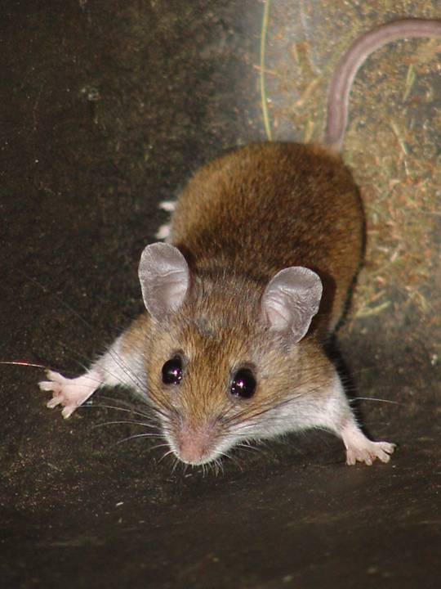
Social Environment and Aggressive Behavior
Cross-fostering California mice (highly aggressive, monogamous, parental care) and white-footed mice (not monogamous, little parental care)
California mice raised by white-footed mice showed less care for young
Also, less aggressive towards intruders
White-footed mice raised by California were more aggressive
These results suggest that experience during development can lead to changes in behaviors which can be passed on

Slide 7
Learning
Learning- the modification of behavior based on specific experiences
Habituation- a loss of responsiveness to stimuli that convey little or no information
Allows for nervous system to focus on helpful stimuli
Spatial learning- the modification of behavior based on experience with the spatial structure of the environment
Wasp pinecone experiment

