Slide 1
Cognitive Maps-Migratory Patterns
JD Howard

Slide 2
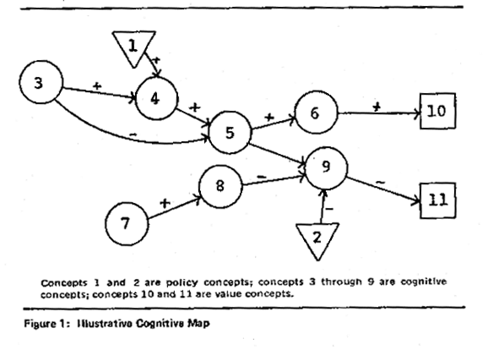
Cognitive Maps
An internal representation, or code, of the spatial relationships between objects in an animal’s surroundings.
Not just landmarks
Birds’ seed caches

Slide 3
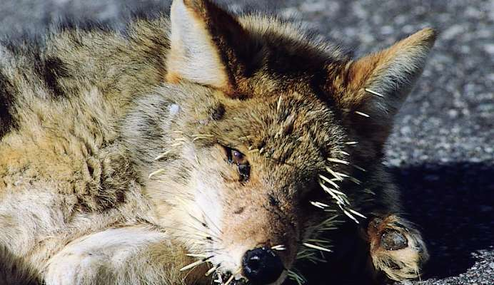
Associative Learning
Ability to associate one feature of the environment with another. (Bright color = bad taste)
Classical conditioning- arbitrary stimulus is associated with a reward or punishment
Operant conditioning- trial and error learning

Slide 4
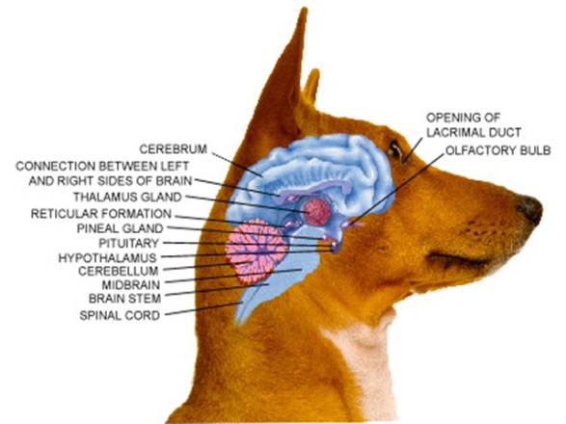
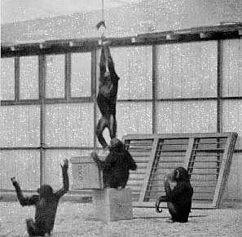
Cognition and Problem Solving
Cognition- the ability of an animal’s nervous system to perceive, store, process, and use information gathered by sensory receptors.
Cognitive ethology-animals
Copy one another

Slide 5
Genetic and Environmental Interaction in Learning
Varies from species to species
White-crowned sparrow learns from peers
Other birds may have their songs “programmed” genetically

Slide 6
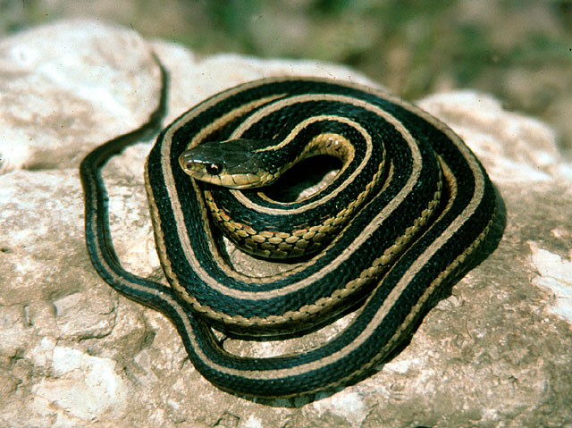
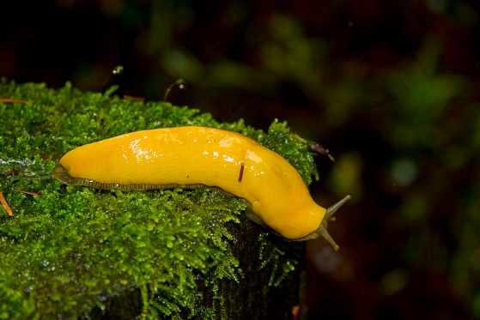
Behavioral Traits by Natural Selection
Behaviors can be selected for
Garter snakes- 2 populations in different habitats eat different prey.
Genes can code for certain behaviors
Aggression can change based on genetics (spiders)

Slide 7
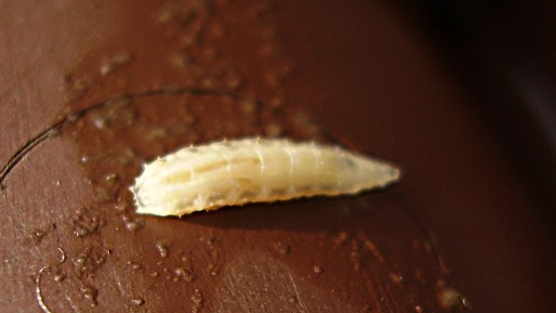
Laboratory Studies of Drosophilia
Genetic behavioral differences were tested (amount of movement while foraging)
Behaviors evolved based on population density

Slide 8
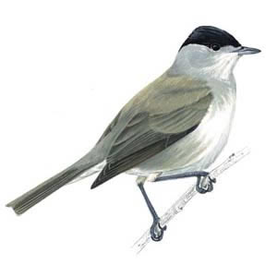
Migratory Patterns
Blackcaps showed strong evidence that migratory patterns are genetic.
The behavior evolved rapidly

