Slide 1
Ecology
Erin Gant

Slide 2
Evolution and Human Culture
Sociobiology- evolutionary theory that certain behaviors are results of genes perpetuated through natural selection
Sociociology: The New Synthesis by E.O. Wilson
Debate over how much of our behavior is determined by genes
Humans have undermined Darwinian fitness

Slide 3
Population Ecology
The study of populations in relation to the environment .
Includes environmental influences on population density, distribution, age structure, and size.

Slide 4
Populations
Population-group of individuals of a single species living in same general area.
Populations have boundaries and specific sizes
Ecologists measure density (individuals per area) and dispersion (pattern of spacing) of populations.

Slide 5
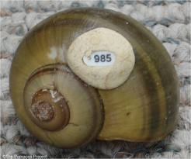
Density
Estimate population size by several small plot samples that can then be used to determine density
Mark-recapture method- capture animals, set them free, recapture animals
Use the ratio of marked to unmarked animals from the second time to determine density

Slide 6
Density changes
Increases
Birth
Immigration
Decreases
Death
emigration

Slide 7
Dispersions
Clumped: attracted to environment that meets their needs/teamwork
Plants, fungi, wolves
Uniform: result of territoriality
Penguins, plants that secrete chemicals
Random: absence of attractions or repulsions
Plants from windblown seeds

Slide 8
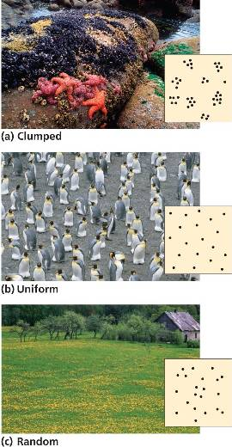
Dispersions

Slide 9
Demography
The study of vital statistics of a population and how they change
Birth rates
Death rates

Slide 10
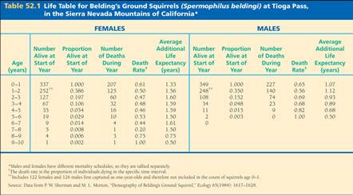
Life Tables
Age specific summaries of individual survival patterns.
Cohort- group of individuals followed from birth to death to construct a life table
Records the percentage of the original cohort still alive each year.

