Slide 1
Demogragphy
Pages 1140-1145
Austin Windsor

Slide 2
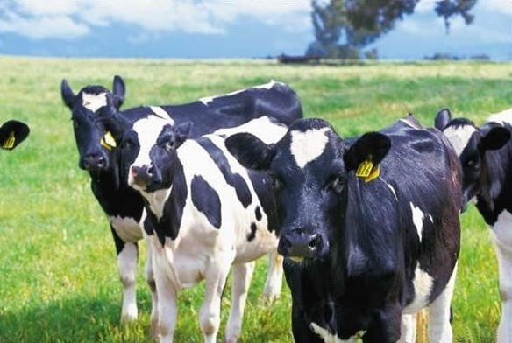
Basics
Study of vital statistics of a population overtime
Ex: Birth rates and death rates
Factors- Biological needs, environment, Community interactions
Cohort- a sample of population for life

Slide 3
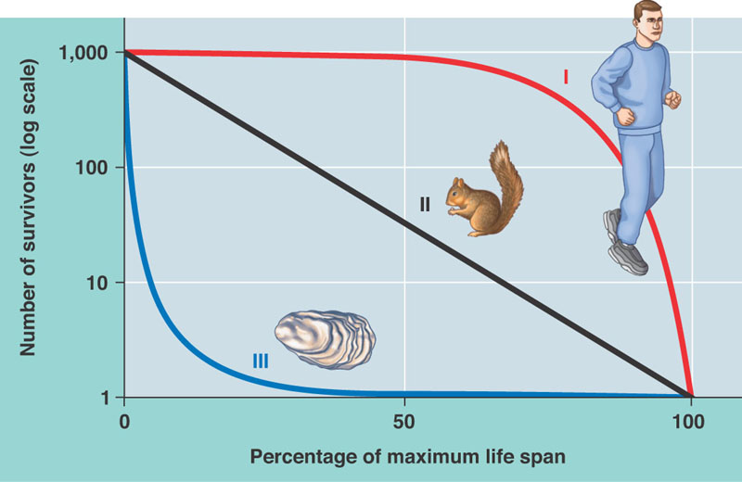
Graphs
Survivorship Curve- tracks deaths of sample over given time period
Males v Females
Longevity
Tracks number of organisms at certain ages
3 types
Type I
Type II
Type III

Slide 4
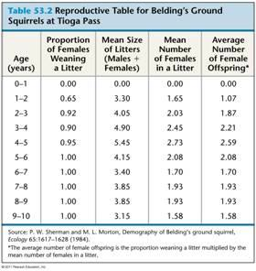
Reproductive Rates
Form reproductive tables to find reproductive rates
Cares only for males
Method
Set up ages as X
Take percent of females with a litter
Multiply % females with litter with % of females littered

Slide 5
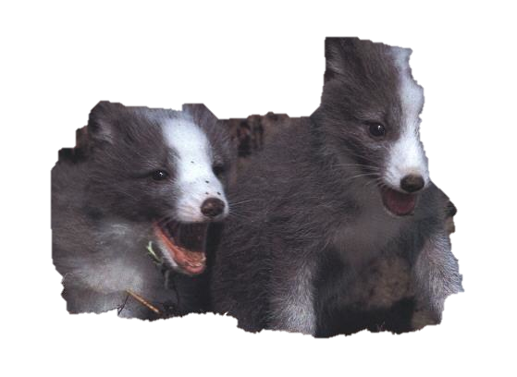
Manner of Reproduction
Big-bang reproduction- semelparity
One try reproduction
More offspring and more energy
Iteroparity- repeated reproduction
Occurs cyclically, few number, well provided

Slide 6
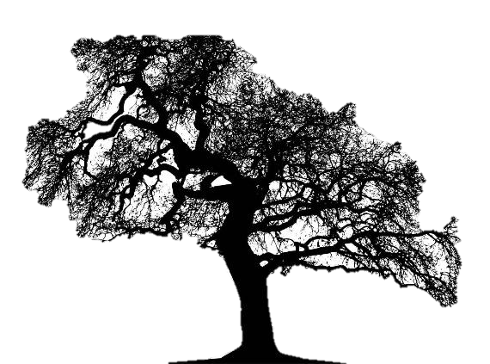
Evolution of Reproduction
Semelparity better for colonizing and non-competitive environments
Iteroparity better in more stable and competitive environments
Both traits hard to evolve because birth takes such a toll on the body and time
Only maximizes one trait at a time

Slide 7
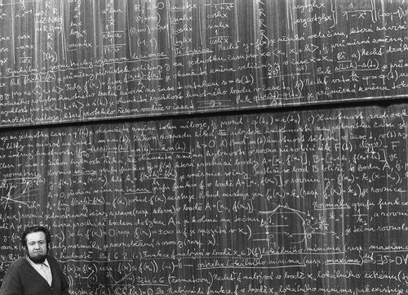
Growth
dN/dt=B-D
Change in population= births-deaths
B=bN or b=B/N
Births= annual per capita birth x #, or annual per capita birth= Birth/#
D=mN (m=mortality rate)
So, dN/dt=bN-mN=N(b-m)
R=b-m so dN/dt=rN
ZPG- Zero population growth

Slide 8
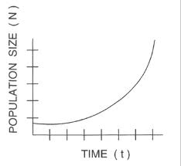
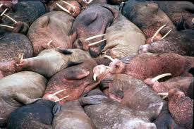
Exponential Growth
Exponential population growth
Would occur if unlimited conditions were met
Limits placed by availability of the materials needed and by community interactions

