Slide 1
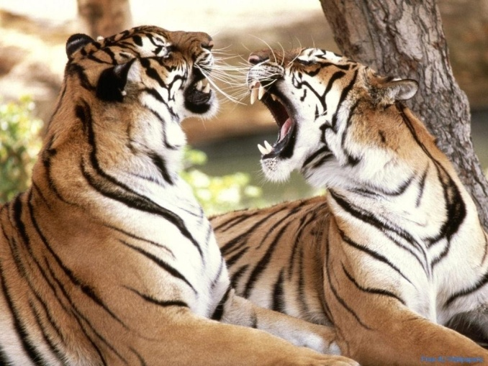
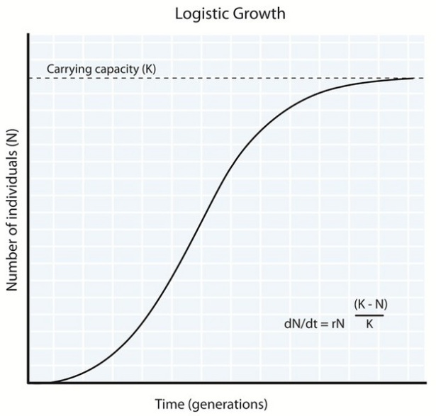
AP Bio Review
Emily Shults
Logistic Growth Model to Intrinsic Factors
Period 4
4/20/2013

Slide 2
Logistic Growth Model-Introduction
As population resources for each individual
Carrying Capacity (k): max population size an environment can support
Varies by limiting resoruces such as energy, shelter, refuge from predators, soil nutrients, water
Crowding and resource limitations effect population growth (slows reproduction rate)
The per capita death rate (m) will increase if not enough energy is consumed

Slide 3
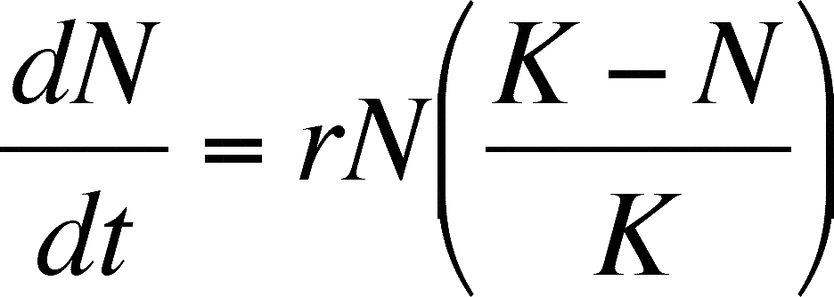
Formula
m= per capita death rate
r= per capita increase
K= maximum carrying capacity
N=population size
(K-N)= number of individuals carrying capacity can support
**Logistic Population Growth Model: Per capita rate of increase declines as carrying capacity is reached**

Slide 4
Explanation…
(K-N) = number of individuals environment can sustain
(K-N)/K is the fraction of K (carying capacity that is still available
By multiplying the exponential rate of increase (rmaxN) by (K-N)/K we are modifying the growth rate as N increases

Slide 5
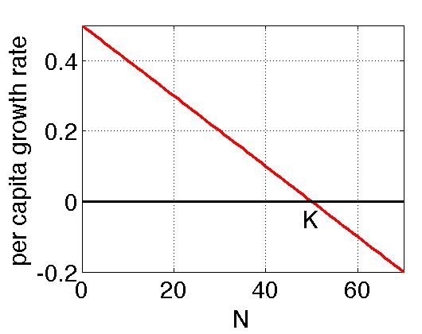
Continued…
When N is small compared to K (population compared to carrying capacity) the term (K-N)/K is close to the instrisic (maximum) rate of increase.
When N is large and resources are limiting, (K-N)/K is small and so is the per capita rate of increase.
When N=K rate is 0 and the population stops growing

Slide 6
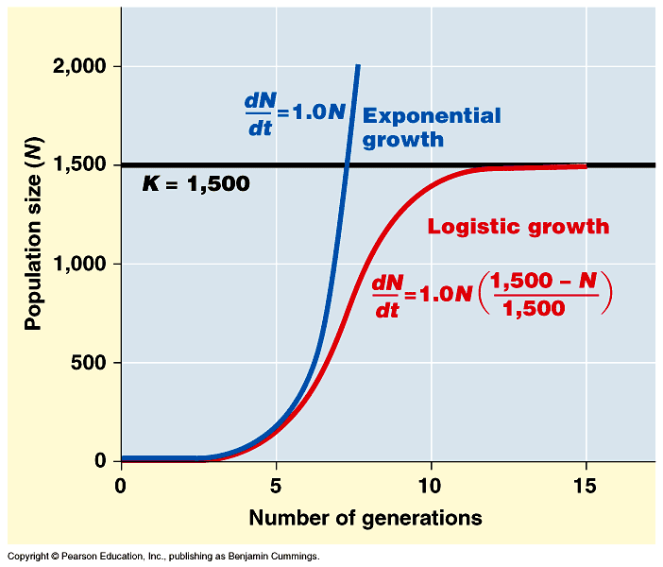
Logistic Growth Model
Produces a sigmoid (S) shape
New individuals are added to population most rapidly at intermediate population sizes (substantial breeding size and resources)
Population dramatically slows as N approaches K
TO DECREASE IN RATE BIRTH RATE MUST DEACREASE OR DEATH RATE MUST INCREASE

Slide 7
Logistic Model
Assumes that populations adjust instantly to growth and apprach carrying capacity smoothly…NOT TRUE (but there is a lag time)
Real World Example: If population of Daphnia drops below K, there is a delay of population growth until increasing # of offspring are born
Also assumes that each individual added to a population has the same negative effect on population growth--not always the case *Allele Effect* (some organisms survive and reproduce better at high population density
Helped to predict possible population fluctuations

Slide 8
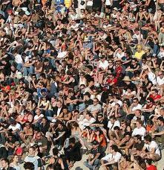
Natural Selection
High Population Density- Not a lot of resources, slow growth, and selection favors individuals that can reproduce with few resources
Low Population Density- Favors traits such as production of numerous, small offspring
HIGH
LOW

Slide 9
K and R Selection
Selection for life history traits that are sensitive to population density is K-Selection or density dependent. They maximize population size and operate in populations living at densities near the limit imposed by resources.
Selection for traits that maximize reproductive success in uncrowded places is R-Selection or density independent. They tend to maximize R an density fluctuates way below carrying capacity.

Slide 10
Population Change and Population Density
Birth/Death rate that doesn’t change with population density is density dependent
Birth/Death rate that does change with population density is density independent
A population might stop growing and reach equillibrium due to combinations of both factors

Slide 11
This graph shows a density dependent birth rate and an independent death rate
This graph shows a density independent birth rate and a density dependent death rate
This graph shows a density dependent birth and death rate

Slide 12
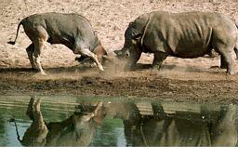
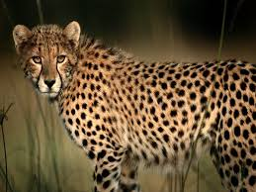
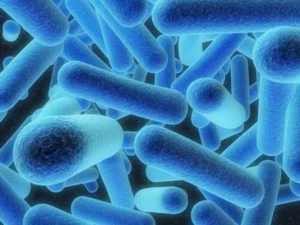
Factors that Affect Population Growth
Competition for Resources: as a bird population density increases by available resources, a female lays fewer eggs (density-dependent response)
Territoriality: Cheetahs are highly territorial and use chemical communications to warn other cheetahs of their boundaries (less habitat and shelter)
Health: influenced by health and survival of organisms-disease. Human pathogens can show density independent infection rates such as TB which is most likely to spread in dense areas.

Slide 13
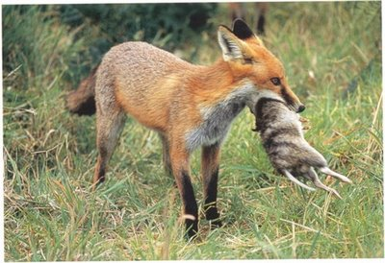
More Factors
Predation: important cause of density-dependent mortality for some prey because a predator encounters and captures more food as population density increases.
Toxic Waste: Affect density dependent regulation of population size metabolic by-products in the lab accumulate as popualtion grows and poisons the organisms in the artificial environment.

Slide 14
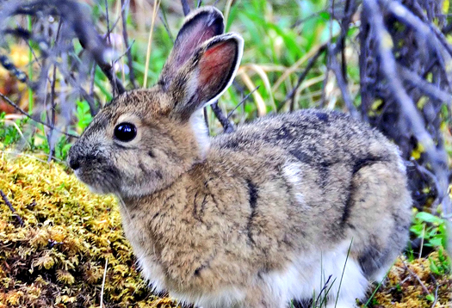
Intrisic Factors
Intrisic (physiological) factors rather than envirnomental factors can affect reproduction of organisms
Aggressive behavior increases with population density
High population densities can cause stress, increase in mortality and decrease in death rates due to hormones released that delay sexual maturation
Stressed bunny

Slide 15
THE END ☺
Bio’s fun.

