Slide 1
Community Ecology
Biogeographic Factors and Views on Community

Slide 2
Biodiversity of a Community
Species diversity in a community is directly related to its location and size.
As both Wallace and Darwin observed, there was greater biodiversity on large, tropical islands near continents than on more remote, smaller islands.
This indicates that biodiversity is not simply a matter of coincidence.

Slide 3
Equatorial-Polar Gradients
Key factors in species richness are evolutionary history and climate
Species diversity increases as speciation events occur, and because tropical communities are generally older and have longer growing seasons, biological time, and hence time for speciation, is faster than in polar regions where more time is spent dormant
Main climatic factors associated with biodiversity: solar energy input and water availability, which can be measured together by measuring a community’s rate of evapotranspiration- the rate of evaporation of water from the soil plus the rate of transpiration of water from plants

Slide 4
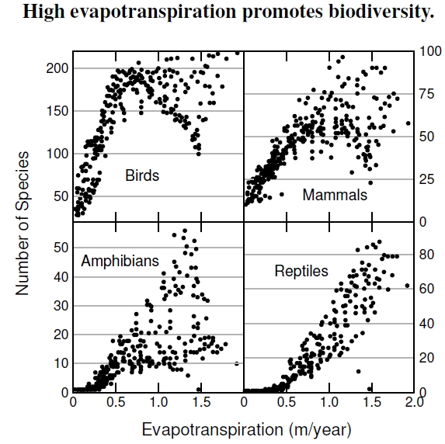
Evapotranspiration
Actual evapotranspiration, determined by solar radiation, temperature, and rainfall, is much higher in hot and humid areas than in cold and dry areas, thus there is more diversity in the tropical areas.
Potential evapotranspiration, determined only by solar radiation and temperature, measures only energy availability and is highest in areas with more hours of sunlight.

Slide 5
Area Effects
Species-Area Curve: all other factors being equal, the larger geographic area of a community, the greater the number of species. (It’s pretty obvious) The explanation being that larger areas have a wider variety of habitats for species to inhabit.
This curve is used in conservation biology to help predict how the loss of habitat will affect a community’s biodiversity.
The slope of the curve depends on the community being sampled; some communities are more effected by area loss than others.

Slide 6
Island Equilibrium Model
Islands are great studies of biodiversity due to their limited size and isolation.
Two factors ultimately determine the equilibrium number of species on an island: the rate of immigration of new species and the rate of extinction of species already there.
Two factors ultimately determine the rate of species immigration and extinction: size (bigger island, more elbow room for each species and better chance a species may happen upon it) and distance from mainland (the closer it is to other land, the easier it is to access).
This model can be considered an oversimplification as it applies to a limited number of locations within short time spans.

Slide 7
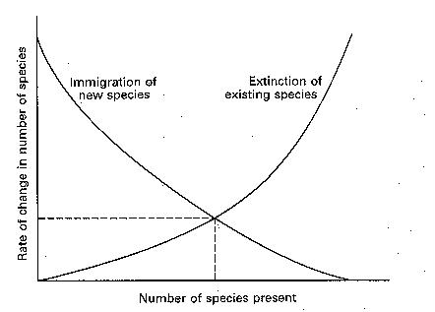
Model of Island Biogeography

Slide 8
Debate of Community Structure
Integrated Hypothesis: the organisms of a community are so closely linked that they are locked into mandatory biotic interactions that cause the community to function as an integrated unit that is basically a superorganism.
Evidence: certain plant life is consistently found together in many different areas but creating, in effect, the same community.
Individualistic Hypothesis: the organisms of a community are found together by chance in a convoluted web of interactions.
Evidence: the plants that are repeatedly found together have the same needs for water, climate, and nutrients, so it is natural they all so happen to succeed in the same areas.

Slide 9
Debate of Community Structure
The Integrated Hypothesis suggests that communities be studied as a whole and that they live in discrete units of all or nothing.
The Individualistic Hypothesis suggests that individual species be studied and that they live as a gradient of each species individually (which is how it seems to appear).

Slide 10
Rivet and Redundancy Models
Rivet Model: Species in a community are like rivets in a plane wing; not all are necessary to hold the wing together, but if one were to remove the rivets one by one, one would eventually be concerned about flying the plane.
Basically, it is a variation on the Integration Model that suggests that most species of a community are tightly linked with others in the community; thus the population of one species affects all species in the community.
Redundancy Model: the species of a community are very loosely linked as for every species there is another that could fill its niche, and thus changing one population does not affect the others which operate independently. It furthers the Individualistic Model.

Slide 11
Debate of Community Structure
The Integrated/Individualistic Model Debate and the Rivet/Redundancy Debate are debates over extreme versions of communities. In reality, community structure probably falls somewhere between each extreme.
Understanding the structure of communities is key to understanding how species extinctions will affect ecosystems and help concentrate conservation efforts where they are especially needed.

