Slide 1
Ecosystems
Cali Sprick
Pages 1184-1190

Slide 2
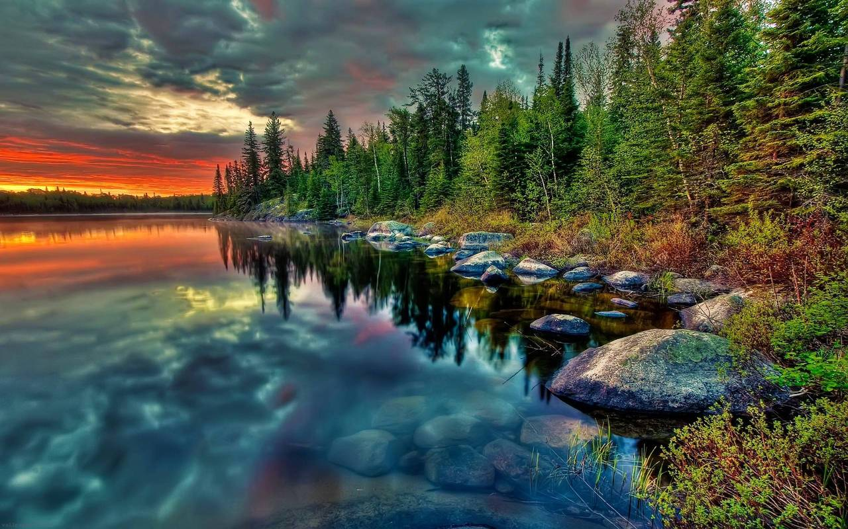
Ecosystem Ecology Emphasizes Energy Flow and Chemical Cycling
Ecosystem ecologists view ecosystems as transformers of energy and processors of mater.

Slide 3

Ecosystems and Physical Laws
An ecosystem consists of all the organisms in a community and all the abiotic factors with which they interact.
The laws of physics and chemistry apply to ecosystems, particularly in regard to the flow of energy.
Energy is conserved, but degraded to heat during ecosystem processes.

Slide 4

Trophic Relationships
Energy and nutrients pass from primary producers (autotrophs) to primary consumers (herbivores) and then to secondary consumers (carnivores).
Energy flows through an ecosystem, entering as light and exiting as heat.
Nutrients cycle within an ecosystem

Slide 5

Decomposition
Decomposition connects all trophic levels.
Detritivores recycle essential chemical elements by decomposing organic material and returning elements to inorganic reservoirs.

Slide 6
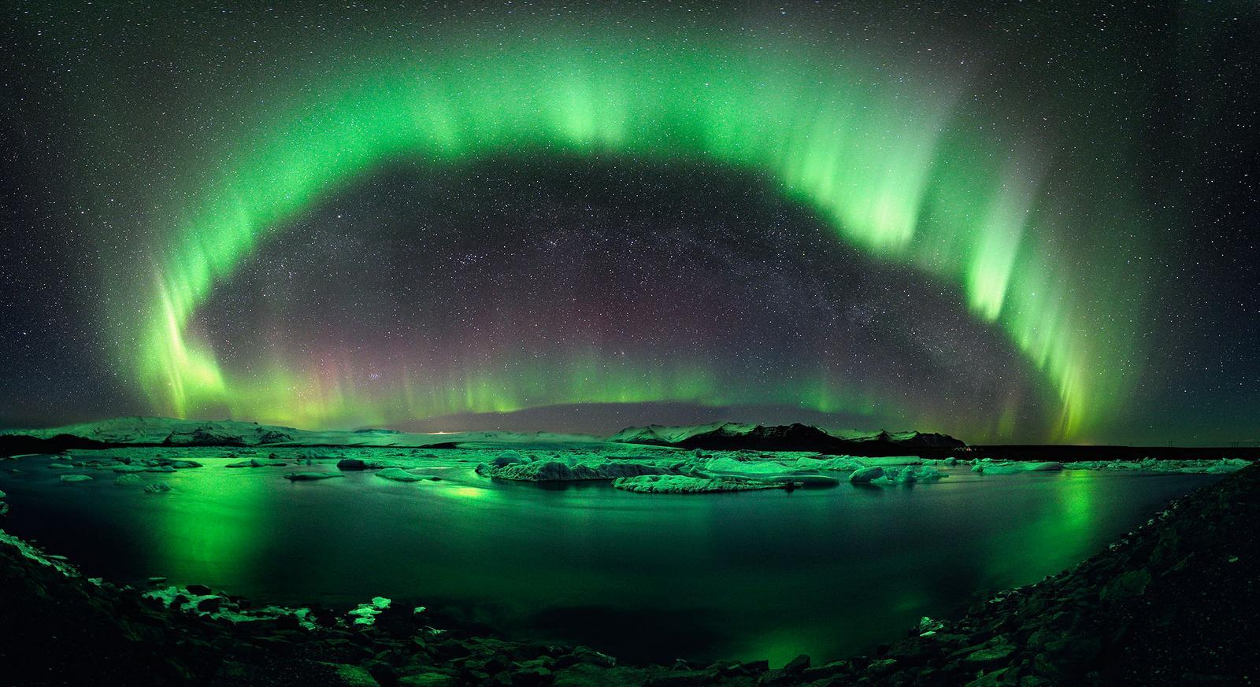
Physical and Chemical Factors Limit Primary Production in Ecosystems
Primary producers use light energy converted to chemical energy by autotrophs during a given time period in an ecosystems Primary Production.
The photosynthetic product is the starting point for studies of ecosystems metabolism and energy flow

Slide 7
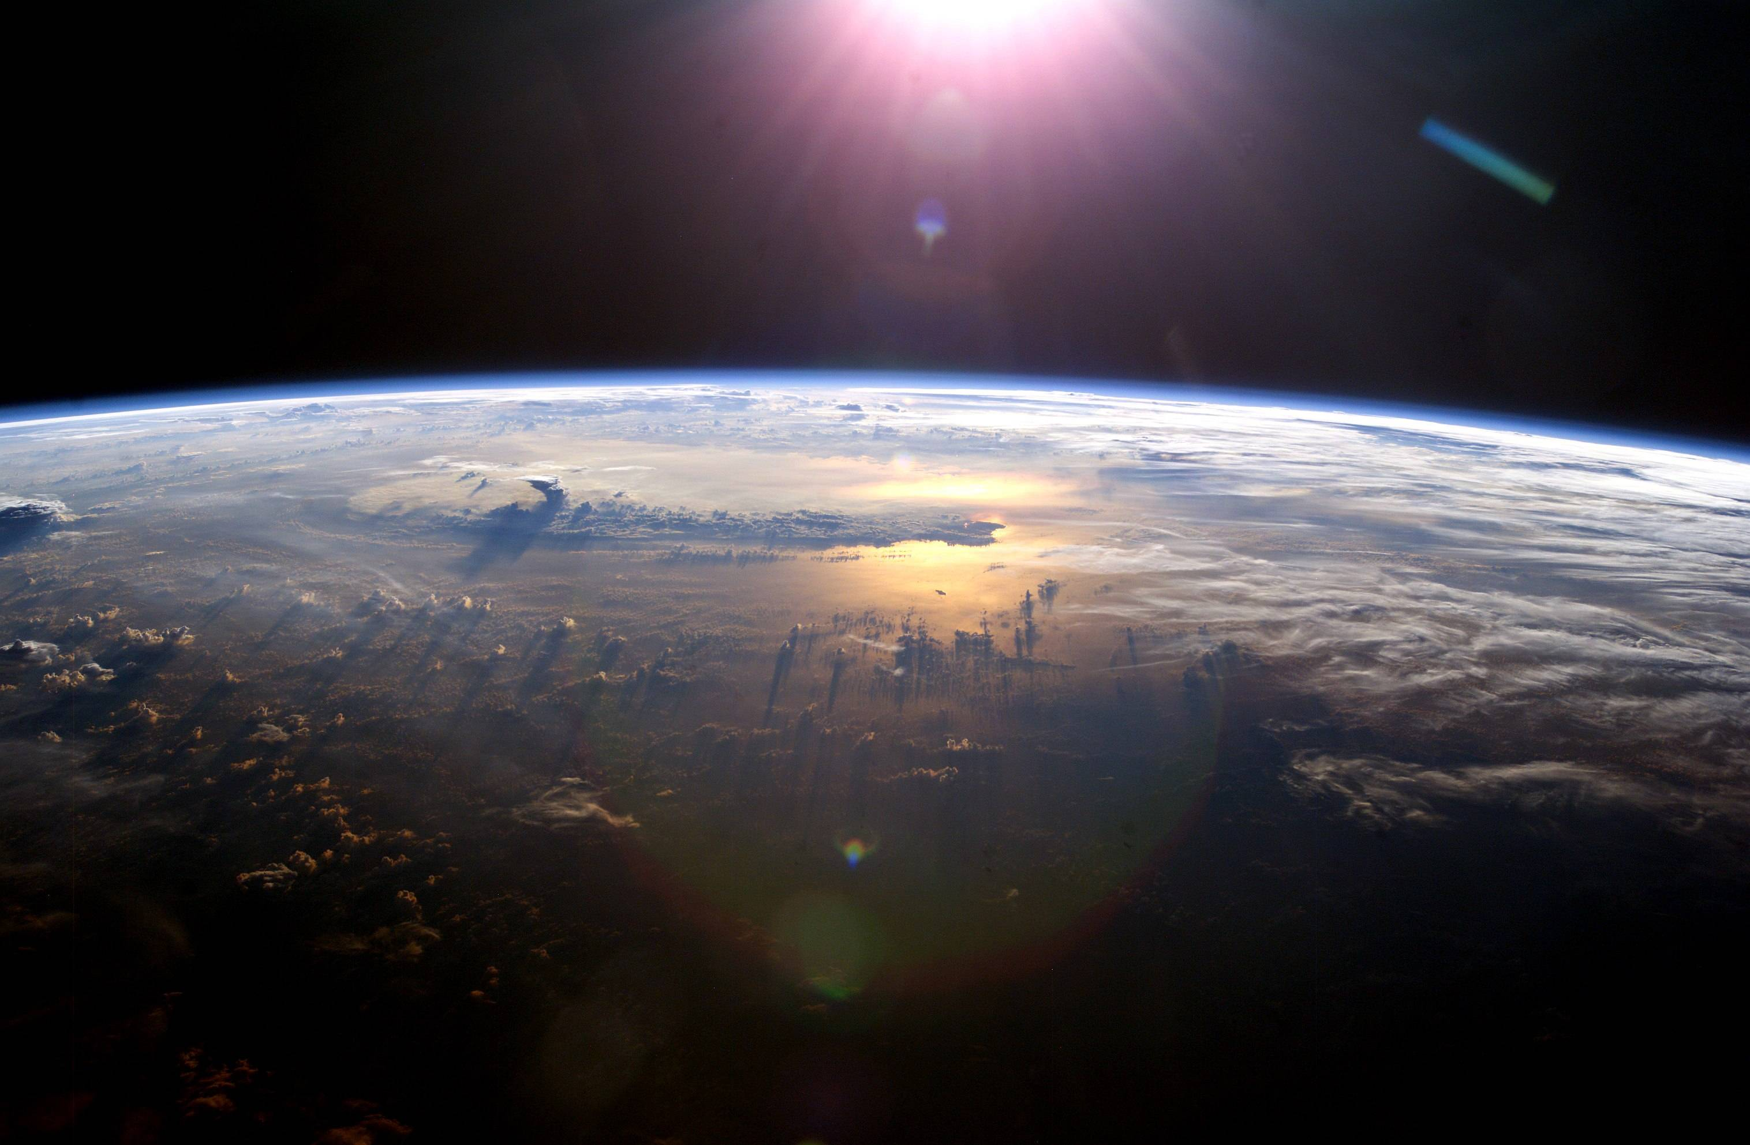
Ecosystem Energy Budgets
primary production sets the spending limit for the global budget.
Gross primary production is the total energy assimilated by an ecosystem in a given time period
                NPP=GPP-R
Only net primary production is available to consumers

Slide 8
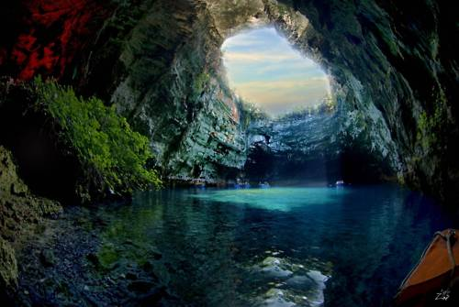
Primary Production in Marine and Freshwater ecosystems
In marine and freshwater ecosystems, light and nutrients limit primary production.
Within the photic zone, the factor that most often limits primary production is a nutrient like nitrogen or iron

Slide 9

Primary Production in Terrestrial and Wetland Ecosystems
In terrestrial and wetland ecosystems, climatic factors such as temperature and moisture affect primary production on a large geographic scale.
More locally, a soil nutrient is often the limiting factor in primary production.

Slide 10
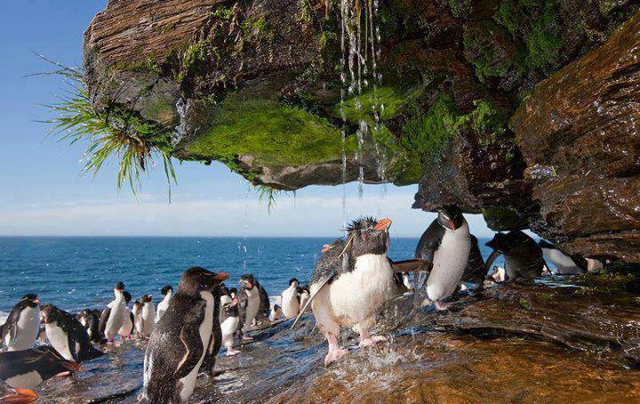
THE END!

