Slide 1
The Biodiversity Crisis
By: Christina Archer

Slide 2
The Biodiversity Crisis
2 disciplines for preserving life:
Conservation biology- integrates ecology, physiology, molecular biology, genetics, and evolutionary biology to conserve biological diversity at all levels
Restoration ecology- applies ecological principles in an effort to return degraded ecosystems to conditions as similar as possible to their natural, predegraded state

Slide 3
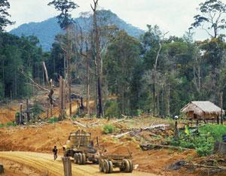
The Biodiversity Crisis
Tropical forests have some of the greatest concentrations of species, but these tropical areas are being destroyed to make room for humans.
Human activities are altering trophic structures, energy flow, chemical cycling, and natural disturbance in the biosphere, which are all ecosystem processes that we depend on.
Human altered land surface= 50%
We use over half of all accessible surface fresh water.
Some of the most productive and diverse aquatic areas are being severely stressed.
The rate of species loss may be as much as 1000 times higher than at any time in the past 100,000 years.

Slide 4
The Three Levels of Biodiversity: species diversity
Species Diversity- the variety of species in an ecosystem throughout the entire biosphere
Endangered species- in danger if extinction throughout all or a significant portion of its range
Threatened species- are considered likely to become endangered in the foreseeable future.
ALL THREE of these are being decreased by human activity.

Slide 5
Three Levels of Biodiversity

Slide 6
Statistics that Illustrate Species Loss
12% of nearly 10,000 known species of birds and 24% of the nearly 5,000 known species of mammals in the world are threatened with extinction.
Of the approx. 20,000 known plant species in the U.S., 200 species have become extinct. 730 plant species in the U.S. are endangered or threatened.
20% of the known freshwater fishes in the world have become extinct or are seriously threatened.
Since 1900, 123 freshwater vertebrate and invertebrate species have become extinct in North America, and hundreds more species are threatened. Extinction rates for North American freshwater fauna are about 5x higher than those for terrestrial animals.
32% of all amphibian species are now either very near extinction or endangered.
AT THE CURRENT RATES OF EXTINCTION, more than half of all currently living plant and animal species will have disappeared by the end of the 21st century.

Slide 7
Ecosystem Diversity
The local extinction of one species can negatively impact the overall species richness of the community.
Ex: Pastures of phytoplankton in the oceans may help moderate the greenhouse effect by consuming massive amounts of CO₂ (photosynthesis and bicarbonate shells)
Some ecosystems are very seriously impacted by humans.
More than 50% of wetlands have been drained and converted to other ecosystems.
Approx. 90% of native riparian (riverbank) communities have been destroyed by overgrazing, flood control, water diversions, lowering of water tables, and invasive plants.

Slide 8
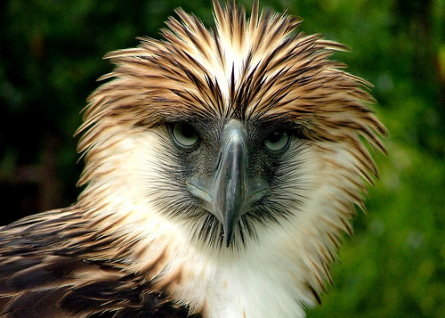
The Hundred Heartbeat Club
These species each have less than 100 individuals remaining on Earth.
Philippine eagle

Slide 9
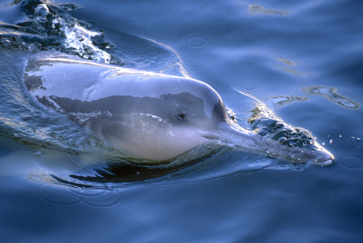
The Hundred Heartbeat Club
Chinese River Dolphin

Slide 10
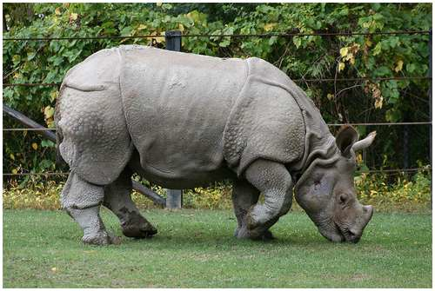
The Hundred Heartbeat Club
Javan Rhinoceros

Slide 11
Biodiversity and Human Welfare
Why do we care about the loss of biodiversity?
Biophilia: our sense of connection to nature and other forms of life
Species diversity brings us many practical benefits.

Slide 12
Benefits of Species and Genetic Diversity
Threatened species could potentially provide crops, fibers, and medicines for human use.
Loss of species = loss of genes
If certain organisms become extinct, we lose the valuable genetic potential they hold in their unique genetic libraries.

Slide 13
Ecosystem Services
Ecosystem Services- all the processes through which natural ecosystems and the species they contain help sustain human life on Earth. For example….
Purification of air and water
Reduction of the severity of droughts and floods
Generation and preservation of fertile soils
Detoxification and decomposition of wastes
Pollination of crops and natural vegetation
Dispersal of seeds
Cycling of nutrients
Control of many agricultural pests by natural enemies
Protection of shorelines from erosion
Protection from UV rays
Moderation of weather extremes
Provision of beauty and recreational opportunities

Slide 14
Ecosystem Services
The functioning of ecosystems is linked to biodiversity
As we, as humans, limit biodiversity, we are in turn reducing the capacity of Earth’s ecosystems to perform processes critical to our own survival.

Slide 15
Four Major Threats to Biodiversity
Most species loss can be traced to four major threats: habitat destruction, introduced species, overexploitation, and disruption of “interaction networks”

Slide 16
Habitat Destruction
Human alteration of habitat is the single greatest threat to biodiversity throughout the biosphere.
Massive destruction of habitats has been brought about by agriculture, urban development, forestry, mining, and pollution.
Habitat loss may mean extinction when there is no alternative
73% of the species who have become endangered, vulnerable, or rare is due to destruction of habitat
Habitat fragmentation almost always lead to species loss

Slide 17
Habitat Destruction
Habitat fragmentation in the Mount Hood National Forest, western U.S.

Slide 18
Habitat Destruction
Major threat to marine biodiversity
93% of coral reefs have been damaged by human activity
40-50% of the reefs could be lost in the next 30 to 40 years
Aquatic habitat destruction and species loss also result from the dams, reservoirs, channel modification, and flow regulation now affecting most of the world’s rivers.

Slide 19
Introduced Species
Also called invasive, non-native, or exotic
They are those that humans move, either intentionally or accidentally, from the species’ native lovations to new geographic regions.
Transplanted species may spread through a new region at exponential rates
Disruption of adopted community
Prey on organisms or outcompetes them for resources
KUDZU!!!
Introduced species contributed to 40% of the extinctions since 1750.

Slide 20
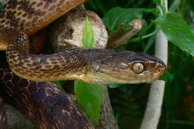
Introduced Species
Brown tree snake, introduced to Guam in cargo.

Slide 21
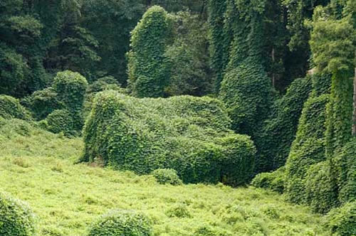
Introduced Species
KUDZU…we’re all pretty familiar with this sight.

Slide 22
Overexploitation
Overexploitation- the human harvesting of wild plants of animals at rates exceeding the ability of the populations of those species to rebound.
Mostly refers to commercial fishing, hunting, collecting, and trading of animals
Vulnerable: large organism with low intrinsic reproduction rates & species with restricted habitats.

Slide 23
Overexploitation

Slide 24
Disruption of Interaction Networks
The extinction of one species can doom others, particularly when the extinction involves a keystone species, an ecosystem engineer, or a species with a highly specialized relationship to others.
Example: The extinction of beavers (huge ecosystem engineers) resulted in a large reduction in wetland and pond habitats across much of North America.

