Slide 1
Population Conservation
By: William Brooks

Slide 2
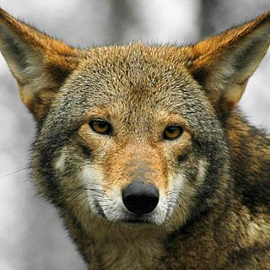
Small population approach
Designated endangered when population very small
Continued habitat loss can lead to extinction

Slide 3
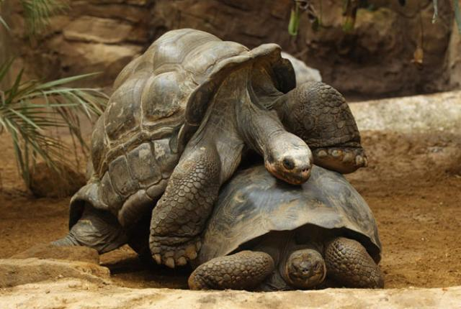
Small population approach
Small population approach- used to study the process of very small populations going extinct

Slide 4
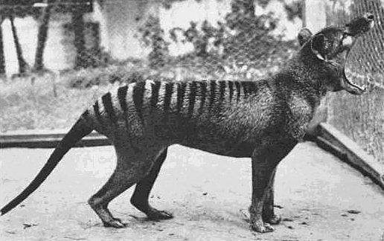
Extinction Vortex
Small populations are prone to positive feedback loops of inbreeding and genetic drift
Extinction vortex- draw populations into smaller and smaller sizes

Slide 5
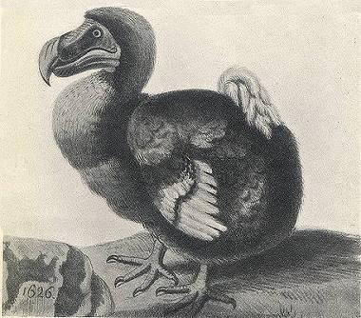
Extinction Vortex
Caused by lack of genetic variation

Slide 6
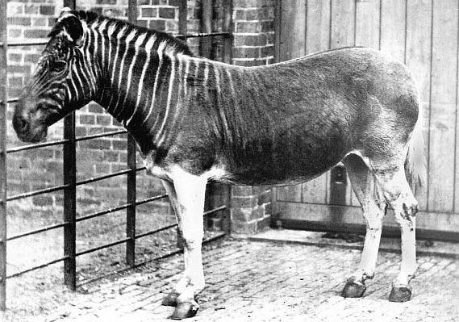
Extinction vortex
Causes low amount of available genetic variation
Low genetic evolution does not always result in extinction

Slide 7
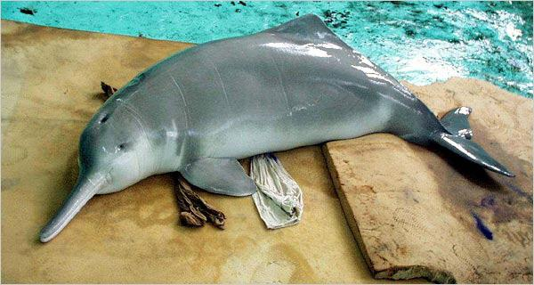
Minimum viable population
Minimum viable population- the least amount of a species able to survive

Slide 8
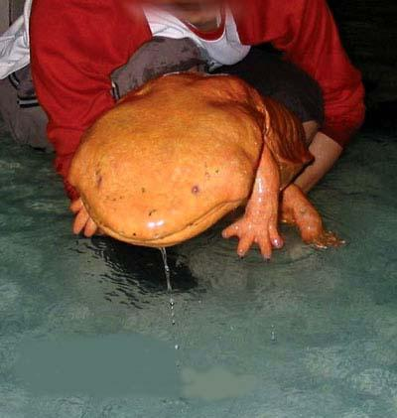
Minimum viable population
Population viability analysis-the analysis to predict a population’s chances for survival. Probability of success/time

Slide 9
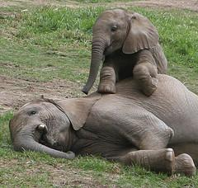
Effective population size
Effective population size- amount of a population that will breed successfully and pass on their alleles.

Slide 10
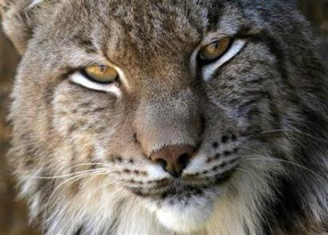
Declining-population Approach
Focuses on threatened and endangered populations
This approach emphasizes environmental factors rather than population size

Slide 11
Steps for Analysis
Assess population trends and distribution to confirm
Study the natural history of the species and related
Develop hypothesis for all possible causes

Slide 12
Steps for Analysis
Test hypothesis
Apply the results of the diagnosis to management of the threatened species

Slide 13
Weighing conflicting demands
Important to weigh the impact of environmental and human concerns

