Slide 1
Landscape and regional conservation chapter 55
Aarij abbas

Slide 2
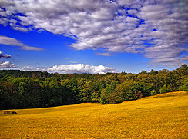
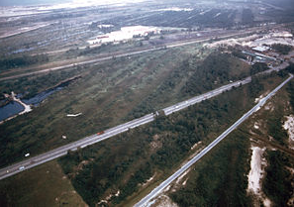
Landscape ecology
Landscape structures
- Edges
- Fragmentation
Effects-
Multiple habitats
Can lead to biased natural selection

Slide 3
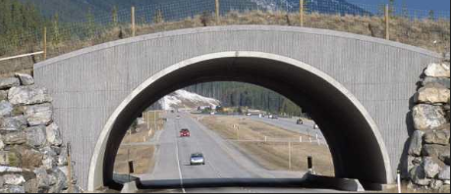
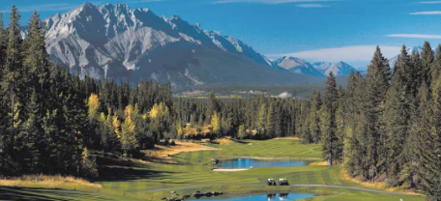
Landscape Ecology
Movement Corridors- a narrow strip of habitat connecting isolated patches
Benefits-
Migration
Population dispersal
Harms-
Diseases

Slide 4
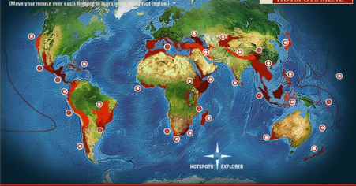
Establishing protected areas
Choosing locations to establish protected areas is a challenging process with many factors to consider
Biodiversity hotspots- a small area with a high concentration of endangered or endemic species
Define endemic specie
Identifying biodiversity hotspots

Slide 5
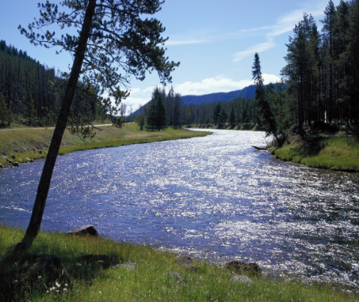
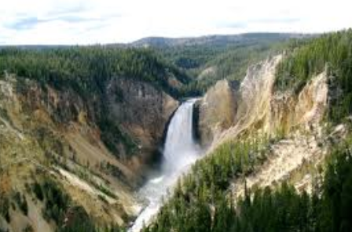
Establishing protected areas
Nature reserves- islands of biodiversity surrounded by human activity. i.e. Yellowstone National Park
Self regulation
- i.e fire dependent species
Size
-biotic boundary

Slide 6
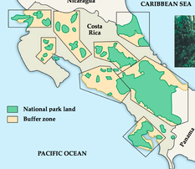
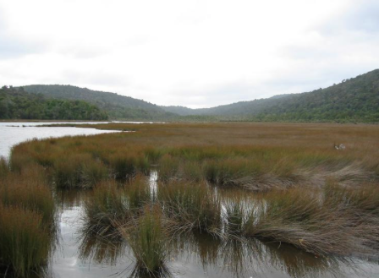
Establishing protected areas
Zone reserves help to integrate economic and social needs into preserving biodiversity
Economic and social climate
Buffer zones
Ex.- estuary

