Slide 1
Natural selection favors behaviors that increase survival and reproductive success
Concept 51.5
Nia Sanders

Slide 2
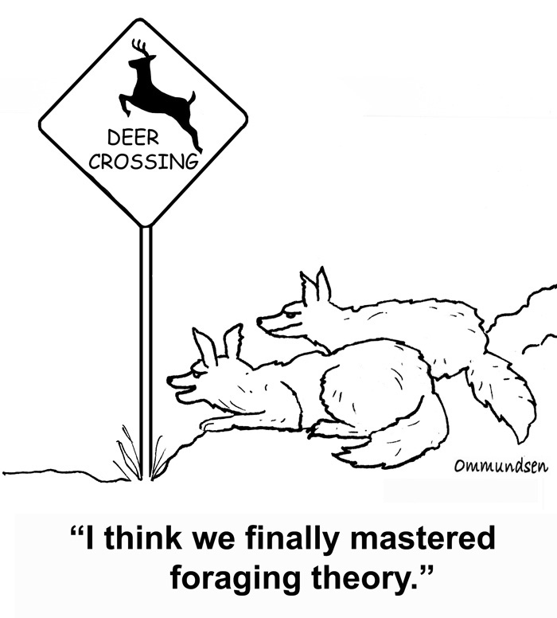
Foraging Behavior
Optimal foraging theory- views foraging behavior as a compromise between the benefits of nutrition and the costs of obtaining food
Natural selection should favor foraging behavior that minimizes cost and maximizes benefits

Slide 3
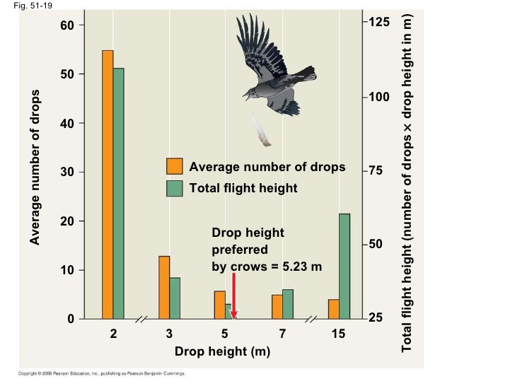
Reto Zach’s Experiment
Northwestern crow and optimum drop height of whelks

Slide 4
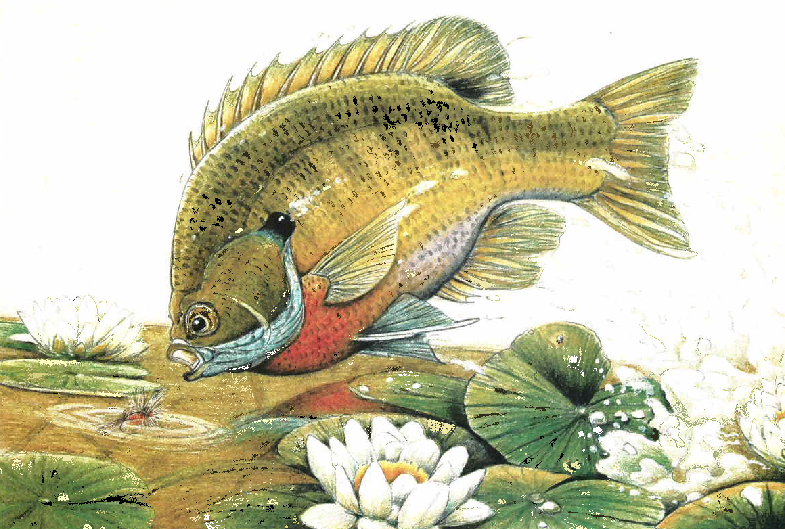
Predicts that the proportion small prey to large prey will also vary with the overall density of prey
Bluegill sunfish and crabs
High prey density focus on the larger crabs

Slide 5
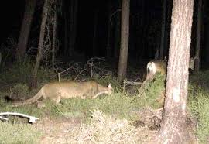
Risk of Predation
To optimize foraging behavior has to watch predators
Learn to adapt based on movement of predators
EX: Mule Deer and the mountain lions
Greater chance to be eaten at the forest edge so they stick to open space

Slide 6
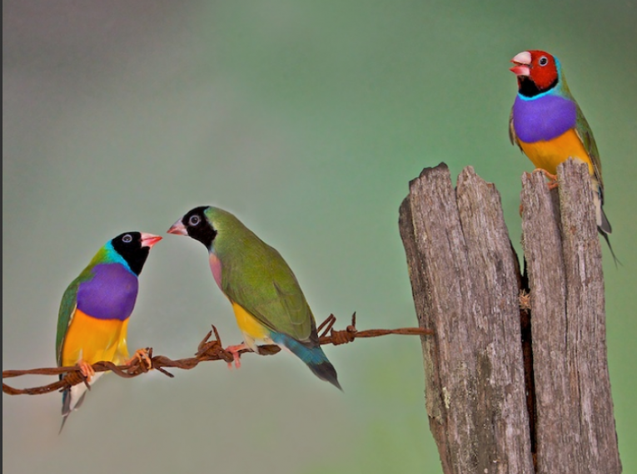
Mating Behavior
Mating behavior is a form of natural selection called sexual selection
Attracting, competing, and seeking mates

Slide 7
Mating System and Parental Care

Slide 8
Types of Relationships
Monogamous-1 male and 1 female
Most are promiscuous- no strong pair bonds or lasting relationships
Polygamous- one sex mates with multiple partners
Polygyny- one male multiple females
Polylandry- one female multiple males
Dimorphic- one sex is bigger and more ornamented

Slide 10
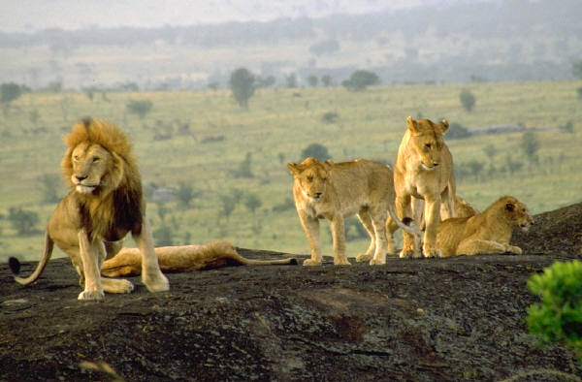
Needs of Young Determine System
Birds are monogamous because the babies cant care for themselves.
Males that aren’t needed maximize reproductive success by being polygamous and protecting the females and the young.

Slide 11
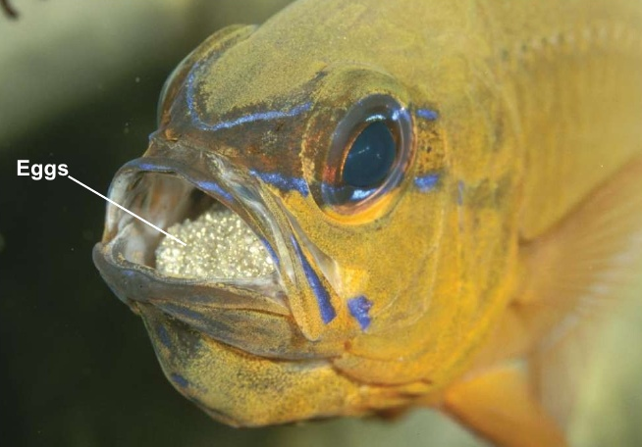
Paternity Certainty
Explains why sole male care is rare in birds and mammals because of the internal fertilization and birth and reproduction occur spread out
External fertilization increases chance of sole male care
More common in fish and amphibians

Slide 12
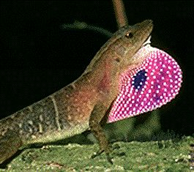
Sexual Selection and Mate Choice
Intersexual Selection- members of one sex choose mates on the basis of particular characteristics
Intrasexual selection- involves competition among members of one sex for mates

Slide 13
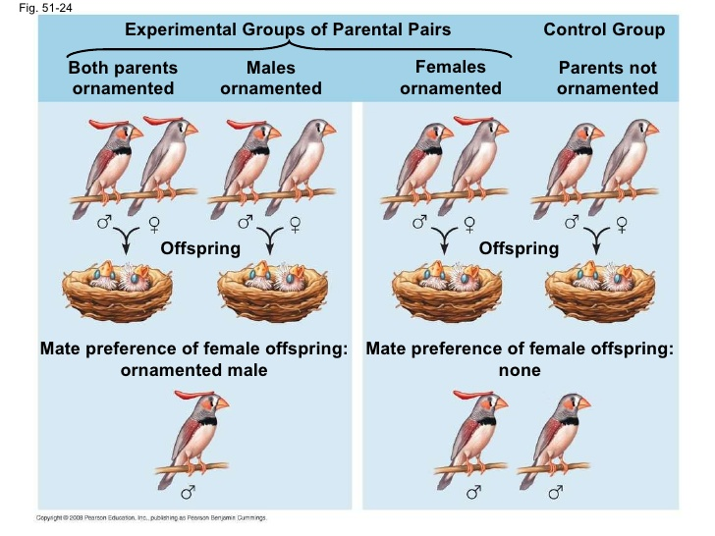
Mate Choice By Females
Experiment on Imprinting
Shows that females imprint on father and there is no male preference

Slide 14
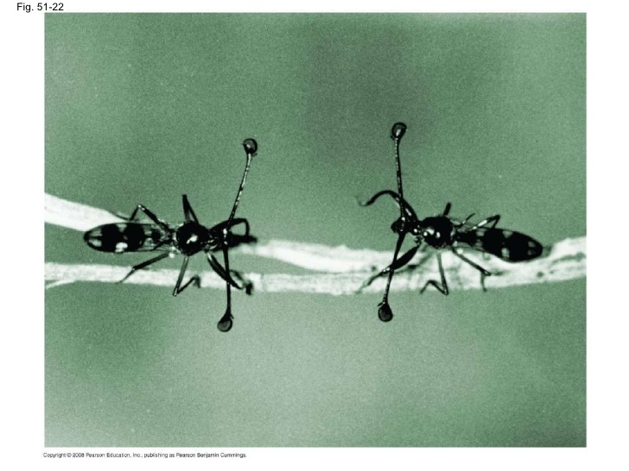
Females base their mate choices on characteristics that correlate with male quality
Long eyestalks or brightly colored feathers in males correlate with health in vitality.

Slide 15
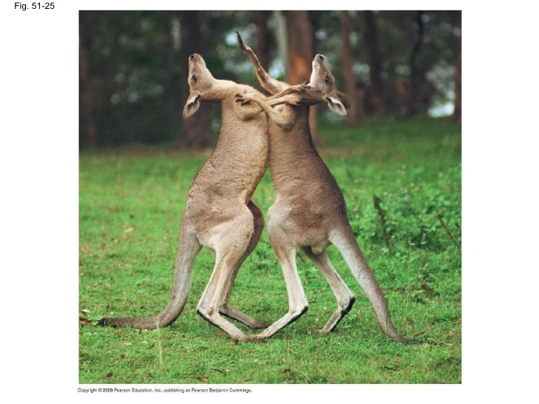
Male Competition for Mates
Agonistic Behavior- ritualized contest that determines which competitor gains access to a resource (food or mates).
Intrasexual selection has led to evolution of alternative male mating behavior and morphology

Slide 16
Paracerceis sculpta (lives in sponges)
Type A male will defend the harems of females against other type A’s
Type B males mimic female morphology and behavior and gain access because they don’t elict defensive respone in A
Tiny Y males invade and live in the harems
A has a majority of females
B has 60%
Y grows with the size of the harem

Slide 17
